Slide 1
Apache kafka
Meltem yılmaz
Big Data Engineer
meltemyilmaz@havelsan.com.tr

Slide 2
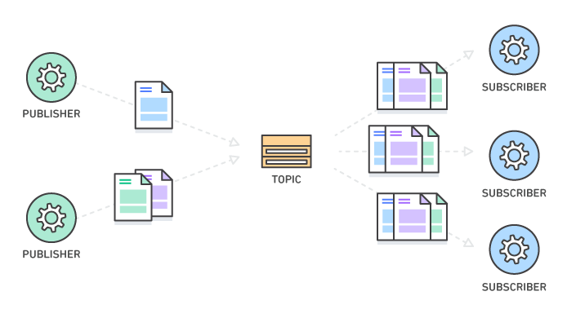
Publish-Subscribe Architecture

Slide 3
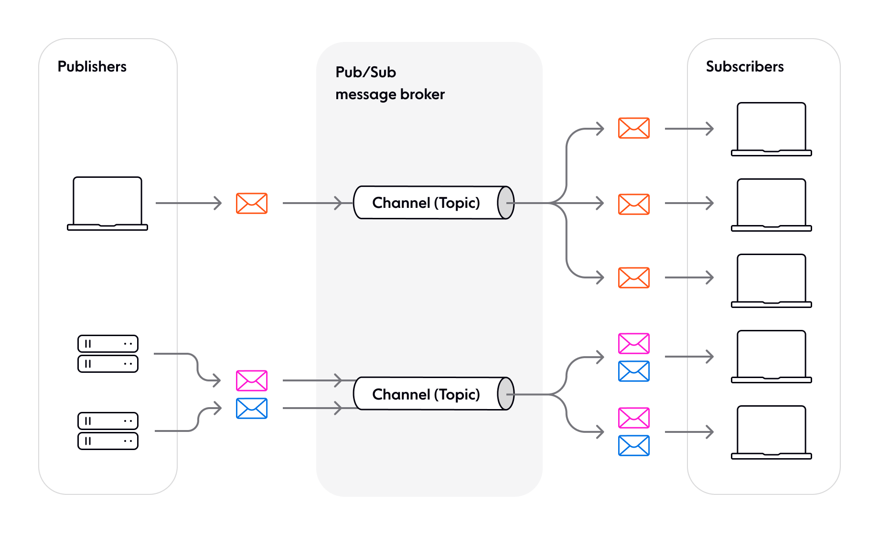
Benefits of the Pub/Sub Model
Loose coupling between components, making your system more modular and flexible.
High scalability (in theory, Pub/Sub allows any number of publishers to communicate with any number of subscribers).
Language-agnostic and protocol-agnostic, which makes it straightforward and fast to integrate Pub/Sub into your tech stack.
Asynchronous, event-driven communication that’s ideal for realtime, low-latency apps.

Slide 4
Purpose of the Using Pub/Sub Model
Sending event notifications.
Distributed caching.
Distributed logging.
Working with multiple data sources.
Broadcasting updates (one-to-many messaging).
Building responsive, low-latency end-user experiences like live chat and multiplayer collaboration functionality.

Slide 5
When Pub/Sub can be a Bad Choice ?
Overkill for simpler systems: Pub/Sub is an overkill for simple systems which are unlikely to scale up. If your system only needs to communicate with a few other components or services, using Pub/Sub might be excessive.
Inappropriate for periodic/background tasks: Pub/Sub is an asynchronous method of sending information. Therefore, it is not suitable for systems that run as periodic background tasks, like cron jobs which are triggered over a particular time period.
Non-event-driven systems: Pub/Sub is typically used in event-driven systems, where components react to changes in the system state. If your system is not event-driven, but instead follows a more traditional request/response or batch processing model, Pub/Sub might not be the best choice.
Synchronous communication: Pub/Sub is designed for asynchronous communication, where the publisher doesn't wait for a response from the subscriber.
Notes:
Overkill for simpler systems: Pub/Sub is an overkill for simple systems which are unlikely to scale up. If you’re operating systems where elastic scaling is not required and where static scaling will suffice, think twice before using Pub/Sub. Similarly, if your system only needs to communicate with a few other components or services, using Pub/Sub might be excessive.
Inappropriate for periodic/background tasks: Pub/Sub is an asynchronous method of sending information. Therefore, it is not suitable for systems that run as periodic background tasks, like cron jobs which are triggered over a particular time period.
Non-event-driven systems: Pub/Sub is typically used in event-driven systems, where components react to changes in the system state. If your system is not event-driven, but instead follows a more traditional request/response or batch processing model, Pub/Sub might not be the best choice.
Synchronous communication: Pub/Sub is designed for asynchronous communication, where the publisher doesn't wait for a response from the subscriber. If you need a synchronous request-response communication pattern, you should consider using something else instead of Pub/Sub.

Slide 6
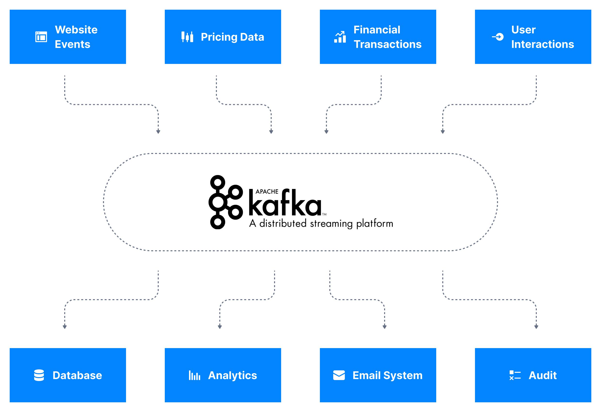
Data stream in Apache Kafka
Apache Kafka is used to store these data streams (also called topics), which then allows systems to perform stream processing. (Performing continual calculations on a potentially endless and constantly evolving source of data.)
Once the stream is processed and stored in Apache Kafka, it may be transferred to another system.

Slide 7

Kafka in Uber
Uber uses Kafka extensively in their real-time pricing pipeline.
Kafka is the backbone through which significant proportion of the events are communicated to the different stream processing calculations.
The speed and flexibility of Kafka allows Uber to adjust their pricing models to the constantly evolving events in the real world such as
Number of available drivers and their position,
Users and their position,
Weather event, other events),
and bill users the right amount to manage offer and demand.

Slide 8
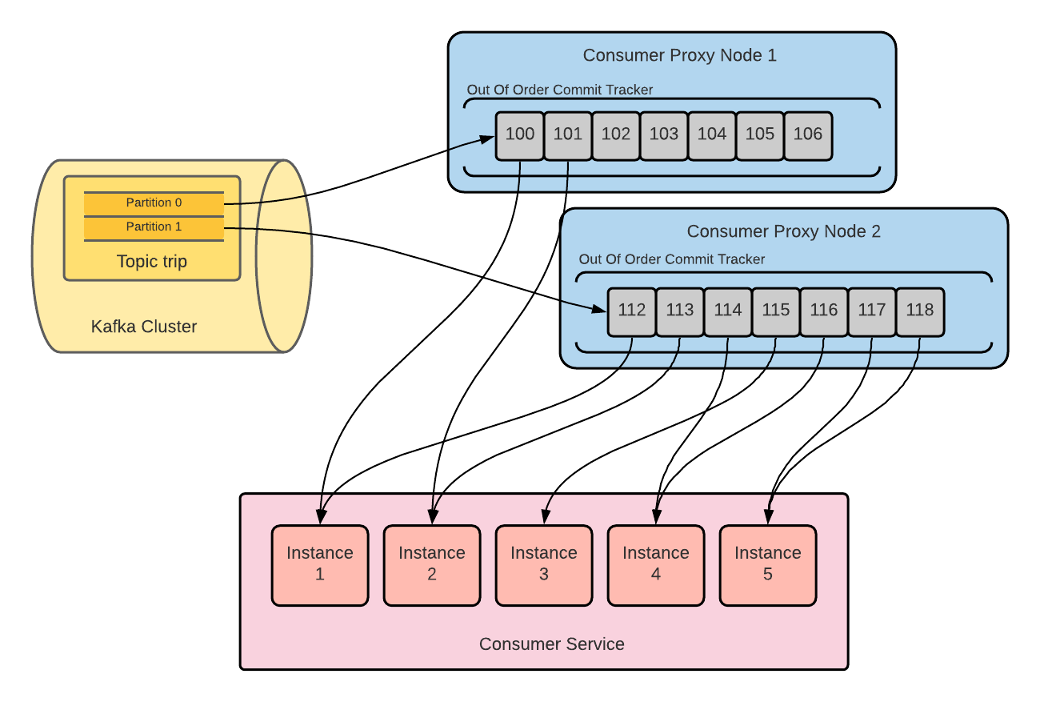
Kafka in Uber
How they overcame the limitations imposed by partitions for non-ordered message consumption, and achieved ?
Partition parallel processing to address the partition scalability problem
Out-of-order commit to guarantee at-least-once message delivery and address the non-uniform processing latency problem
Dead Letter Queue (DLQ) to address the poison pill message problem
Parallel processing of messages within a single partition can be achieved by simply consuming a batch of messages in the Consumer Proxy cluster, and then sending them parallelly to multiple instances of the Consumer Service.
Although a single Kafka topic partition is still consumed by a single Consumer Proxy node, this single node can send messages to any number of consumer service instances. Therefore, the number of consumer service instances is not limited by the number of Kafka topic partitions anymore.
Source: https://www.uber.com/en-TR/blog/kafka-async-queuing-with-consumer-proxy/

Slide 9

Kafka in Netflix
Netflix has integrated Kafka as the core component of its data platform. They refer to it internally as their Keystone data pipeline.
As part of Netflix's Keystone, Kafka handles billions of events a day.
Just to give an idea about the huge amount of data that Kafka can handle, Netflix sends about 5 hundred billion events and 1.3 petabytes of data per day into Kafka.

Slide 10
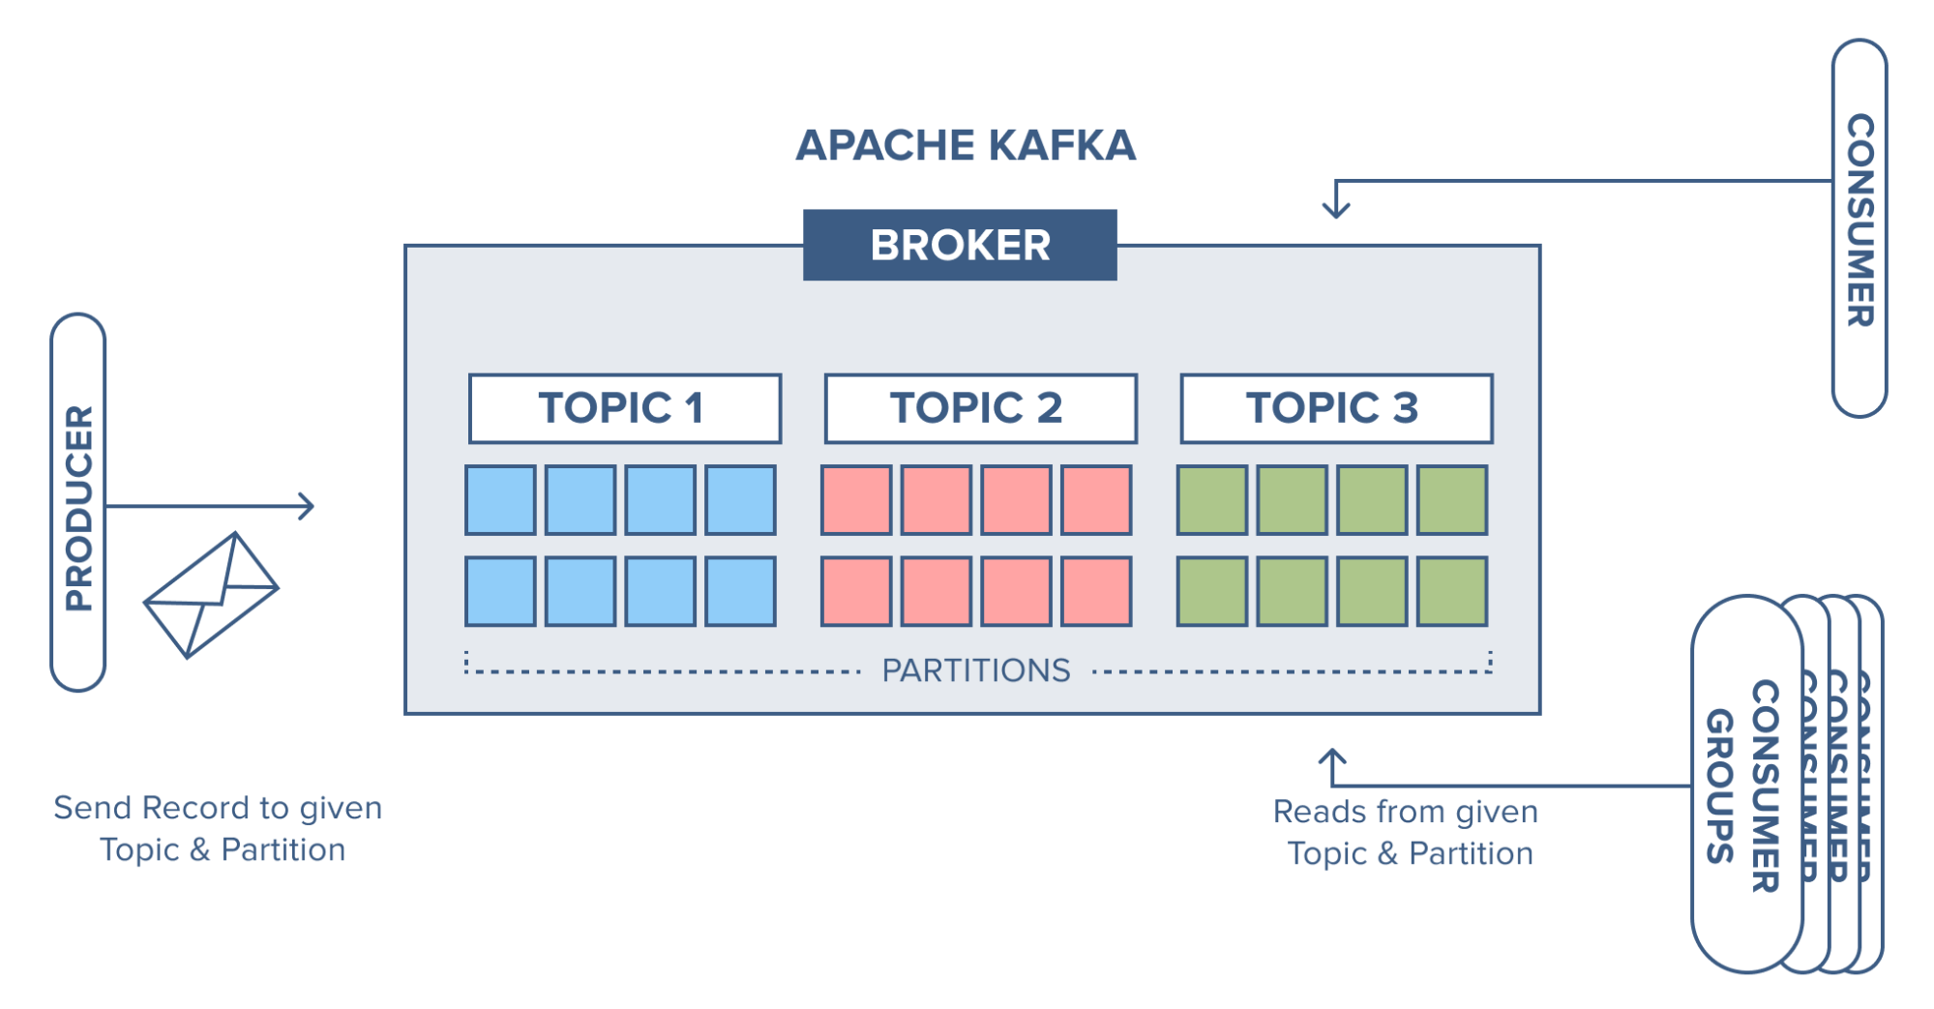
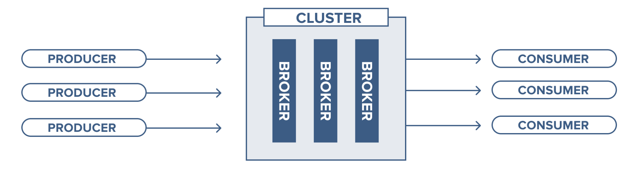
Apache Kafka Core Concepts
Broker: Handles all requests from clients (produce, consume, and metadata) and keeps data replicated within the cluster. There can be one or more brokers in a cluster.
Zookeeper: Keeps the state of the cluster (brokers, topics, users).
Producer: Sends records to a broker.
Consumer: Consumes batches of records from the broker.

Slide 11
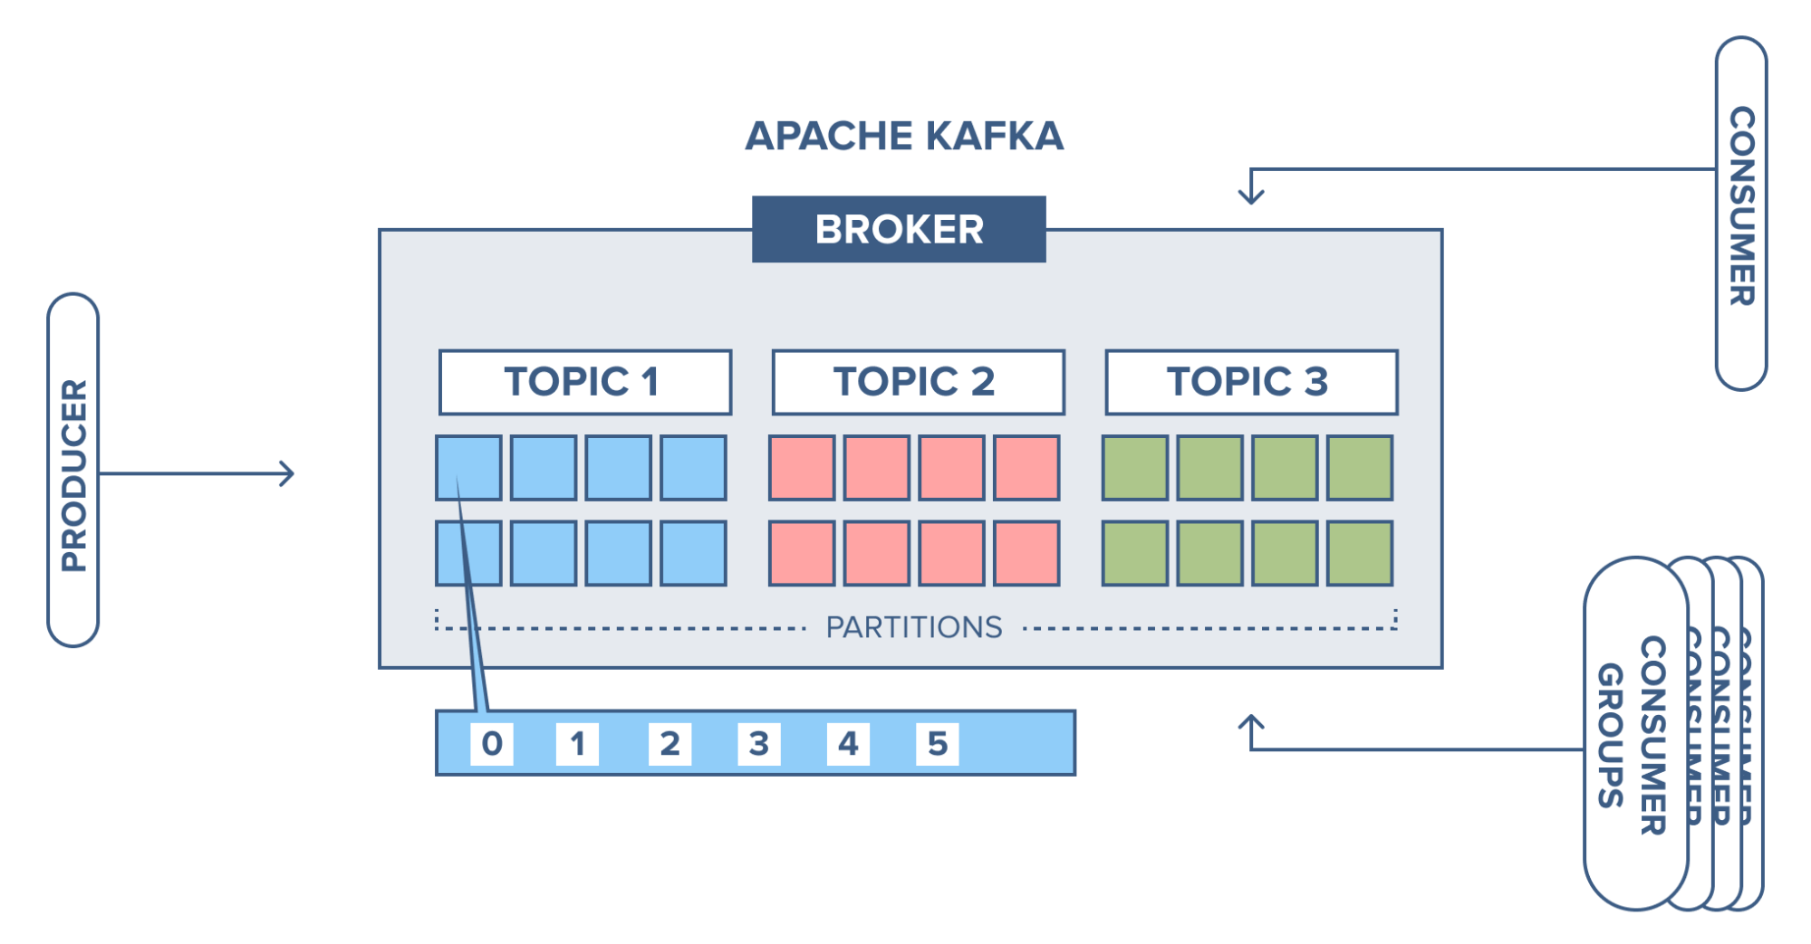
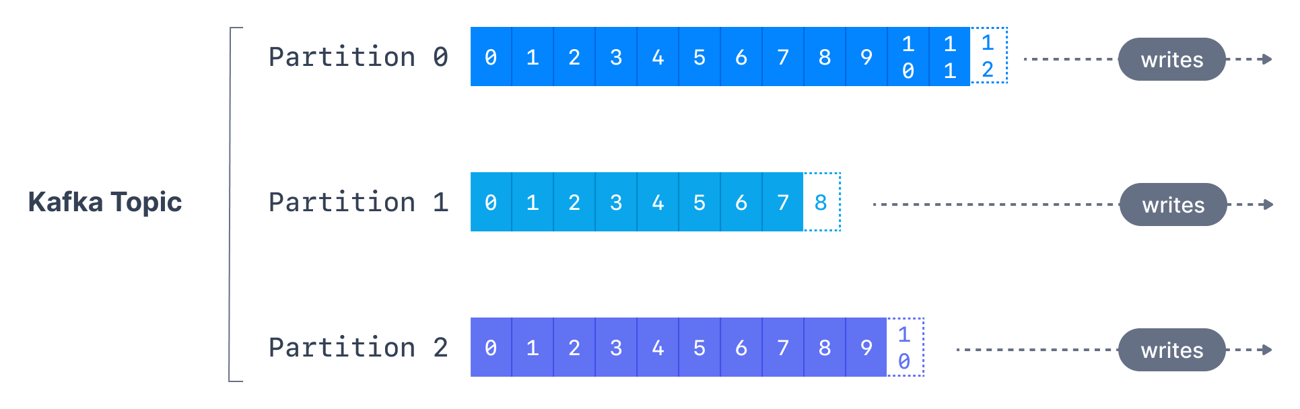
Apache Kafka Core Concepts
A topic is a category/feed name to which records are stored and published.
Kafka retains records in the log, making the consumers responsible for tracking the position in the log, known as the “offset”.
Offset numbering for every partition starts at 0 and is incremented for each message sent to a specific Kafka partition.
Notes:
Typically, a consumer advances the offset in a linear manner as messages are read. However, the position is actually controlled by the consumer, which can consume messages in any order.
E.g. a consumer can reset to an older offset when reprocessing records.

Slide 12
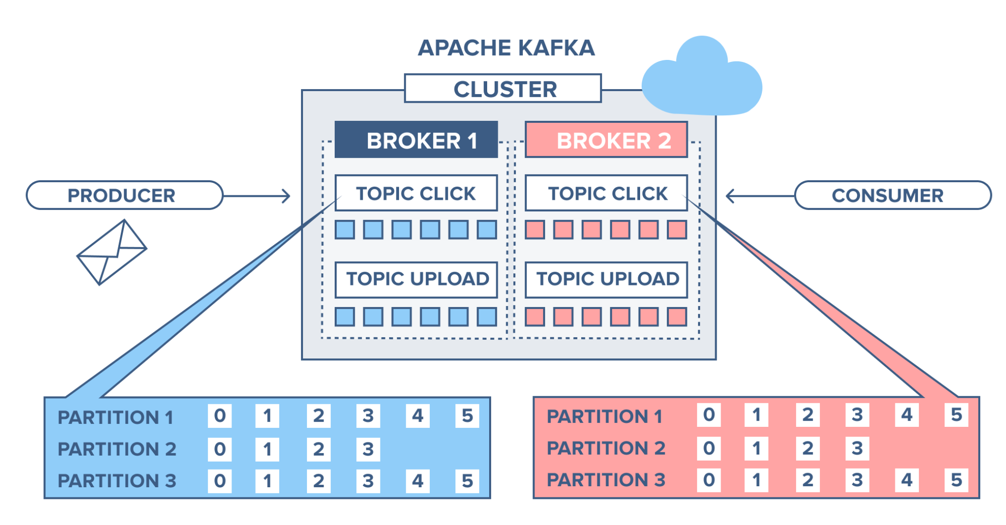
Apache Kafka Core Concepts
Kafka topics are divided into a number of partitions, which contain records in an unchangeable sequence.
Each record in a partition is assigned and identified by its unique offset.
Partitions allow topics to be parallelized by splitting the data into a particular topic across multiple brokers.

Slide 13
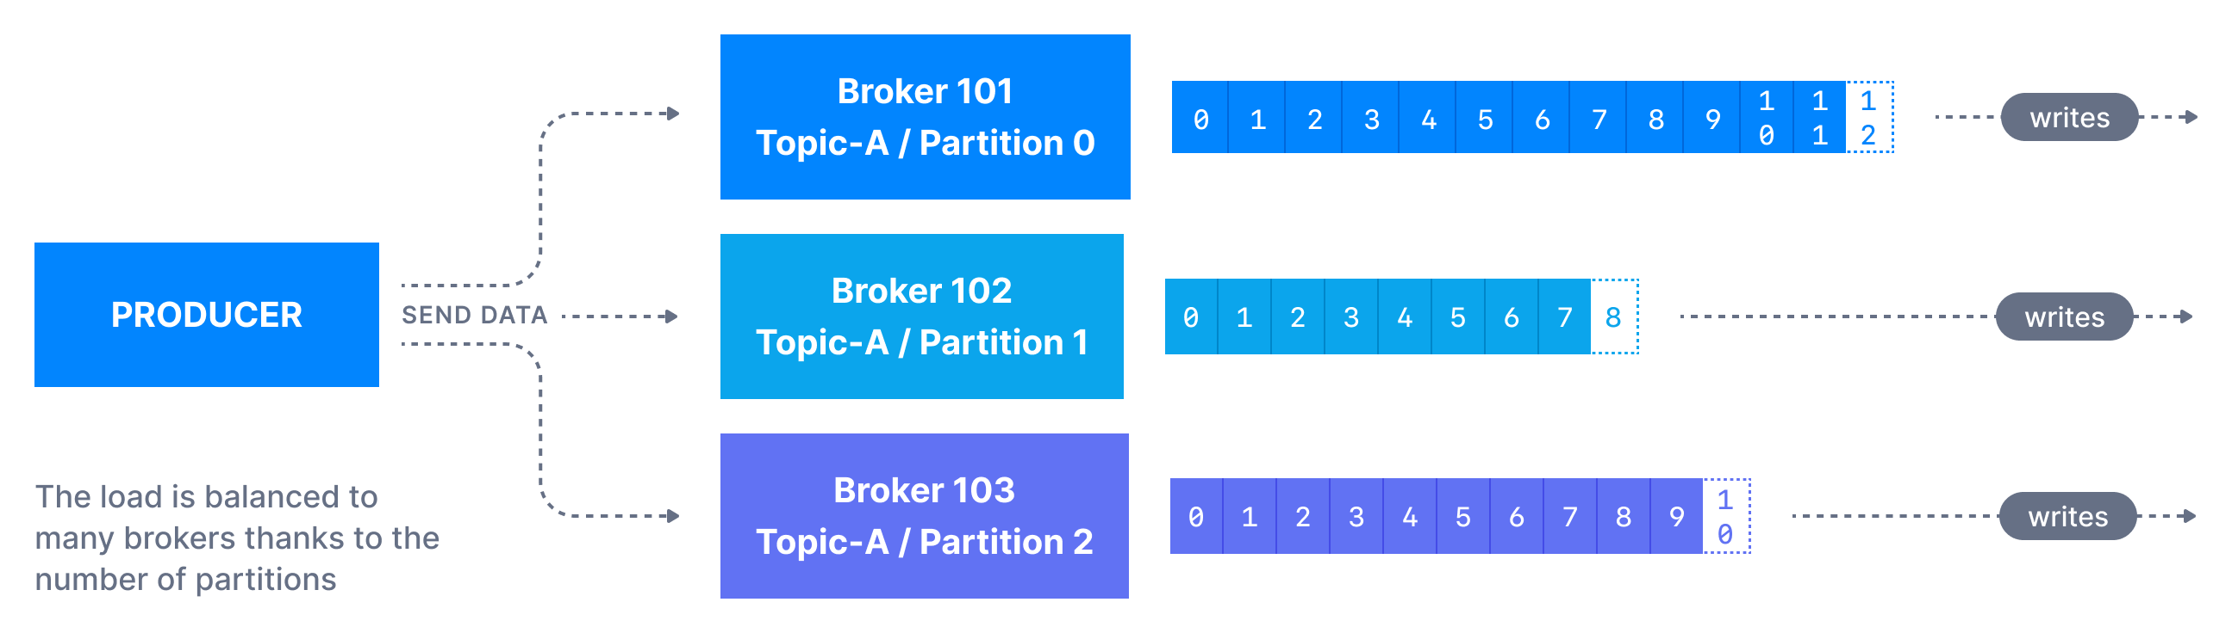
Kafka Producers
A Kafka producer sends messages to a topic, and messages are distributed to partitions according to a mechanism such as key hashing.
If a key is sent (key != null), then all messages that share the same key will always be sent and stored in the same Kafka partition. A key can be anything to identify a message - a string, numeric value, binary value, etc.
For a message to be successfully written into a Kafka topic, a producer must specify a level of acknowledgment (acks).

Slide 14
Kafka Producers
Kafka producers only write data to the current leader broker for a partition.
Kafka producers must also specify a level of acknowledgment acks to specify if the message must be written to a minimum number of replicas before being considered a successful write.
acks=0
acks=1
acks=none

Slide 15
Kafka Producers
When acks=0 producers consider messages as "written successfully" the moment the message was sent without waiting for the broker to accept it at all.

Slide 16
Kafka Producers
When acks=1 producers consider messages as "written successfully" when the message was acknowledged by only the leader.

Slide 17
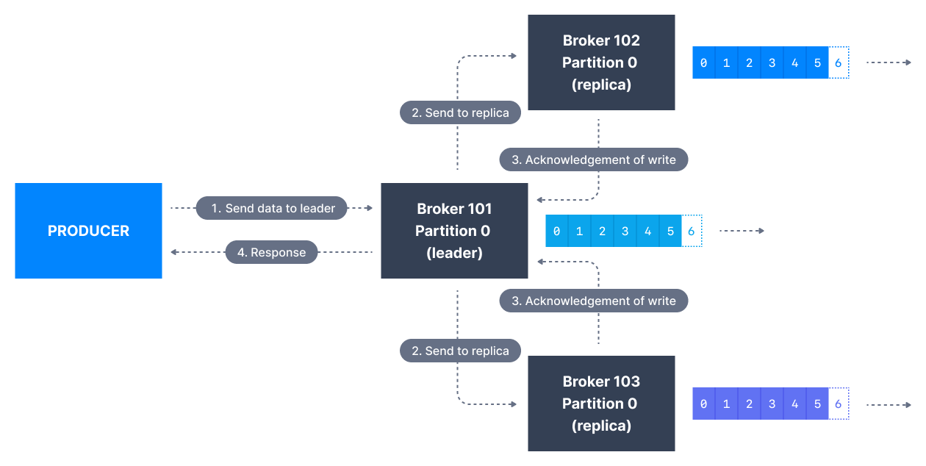
Kafka Producers
When acks=all producers consider messages as "written successfully" when the message is accepted by all in-sync replicas (ISR).

Slide 18
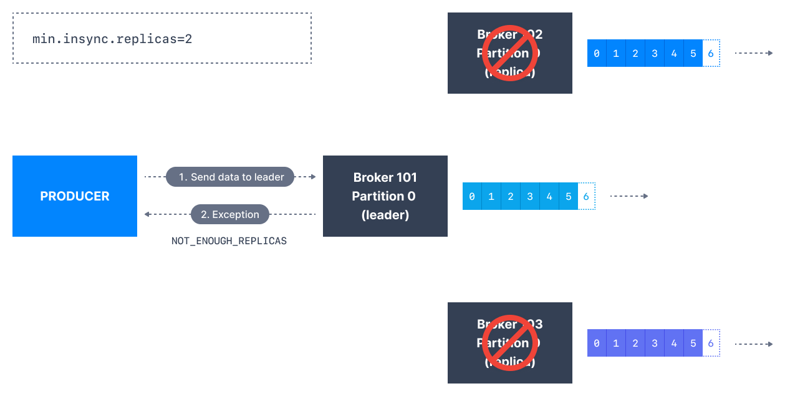
Kafka Producers
The lead replica for a partition checks to see if there are enough in-sync replicas for safely writing the message (controlled by the broker setting min.insync.replicas).
The request will be stored in a buffer until the leader observes that the follower replicas replicated the message, at which point a successful acknowledgement is sent back to the client.
Notes:
If you would like to be sure that committed data is written to more than one replica, you need to set the minimum number of in-sync replicas to a higher value. If a topic has three replicas and you set min.insync.replicas to 2, then you can only write to a partition in the topic if at least two out of the three replicas are in-sync. When all three replicas are in-sync, everything proceeds normally. This is also true if one of the replicas becomes unavailable. However, if two out of three replicas are not available, the brokers will no longer accept produce requests. Instead, producers that attempt to send data will receive NotEnoughReplicasException.

Slide 19
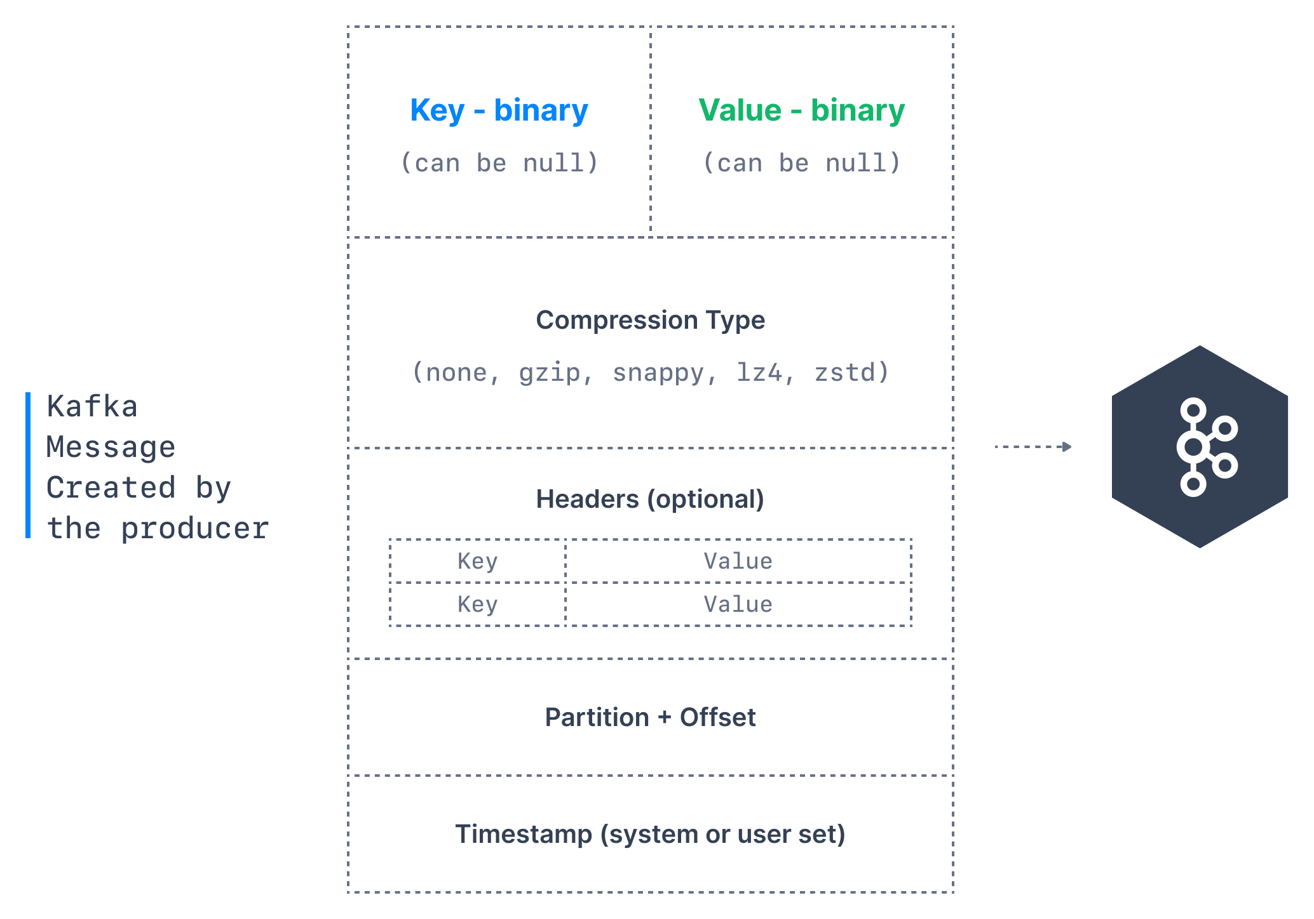
Kafka Message Anatomy

Slide 20
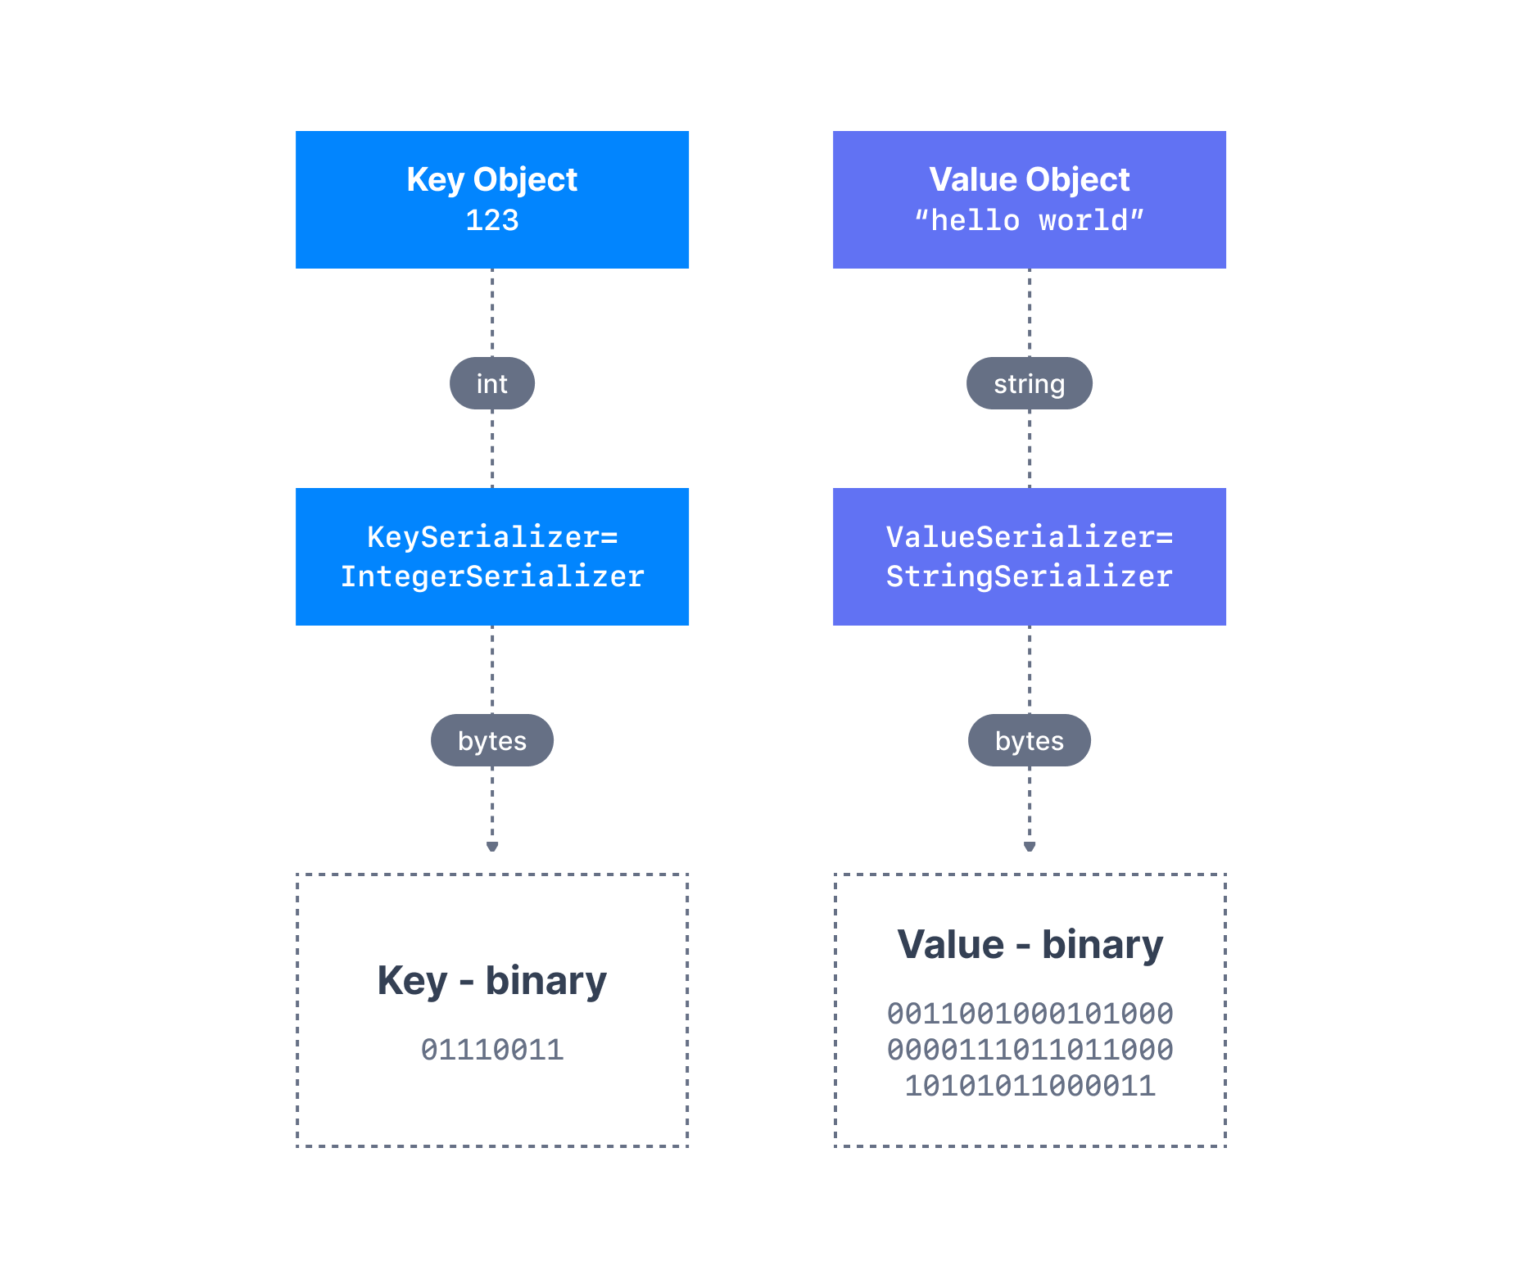
Kafka Message Serializers
Kafka brokers expect byte arrays as keys and values of messages.
The process of transforming the producer's programmatic representation of the object to binary is called message serialization.

Slide 21
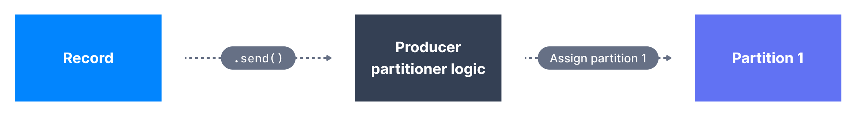
Kafka Message Key Hashing
Key Hashing is the process of determining the mapping of a key to a partition.
In the default Kafka partitioner, the keys are hashed using the murmur2 algorithm.
targetPartition = Math.abs(Utils.murmur2(keyBytes)) % (numPartitions - 1)
All messages with the same key will go to the same partition.

Slide 22
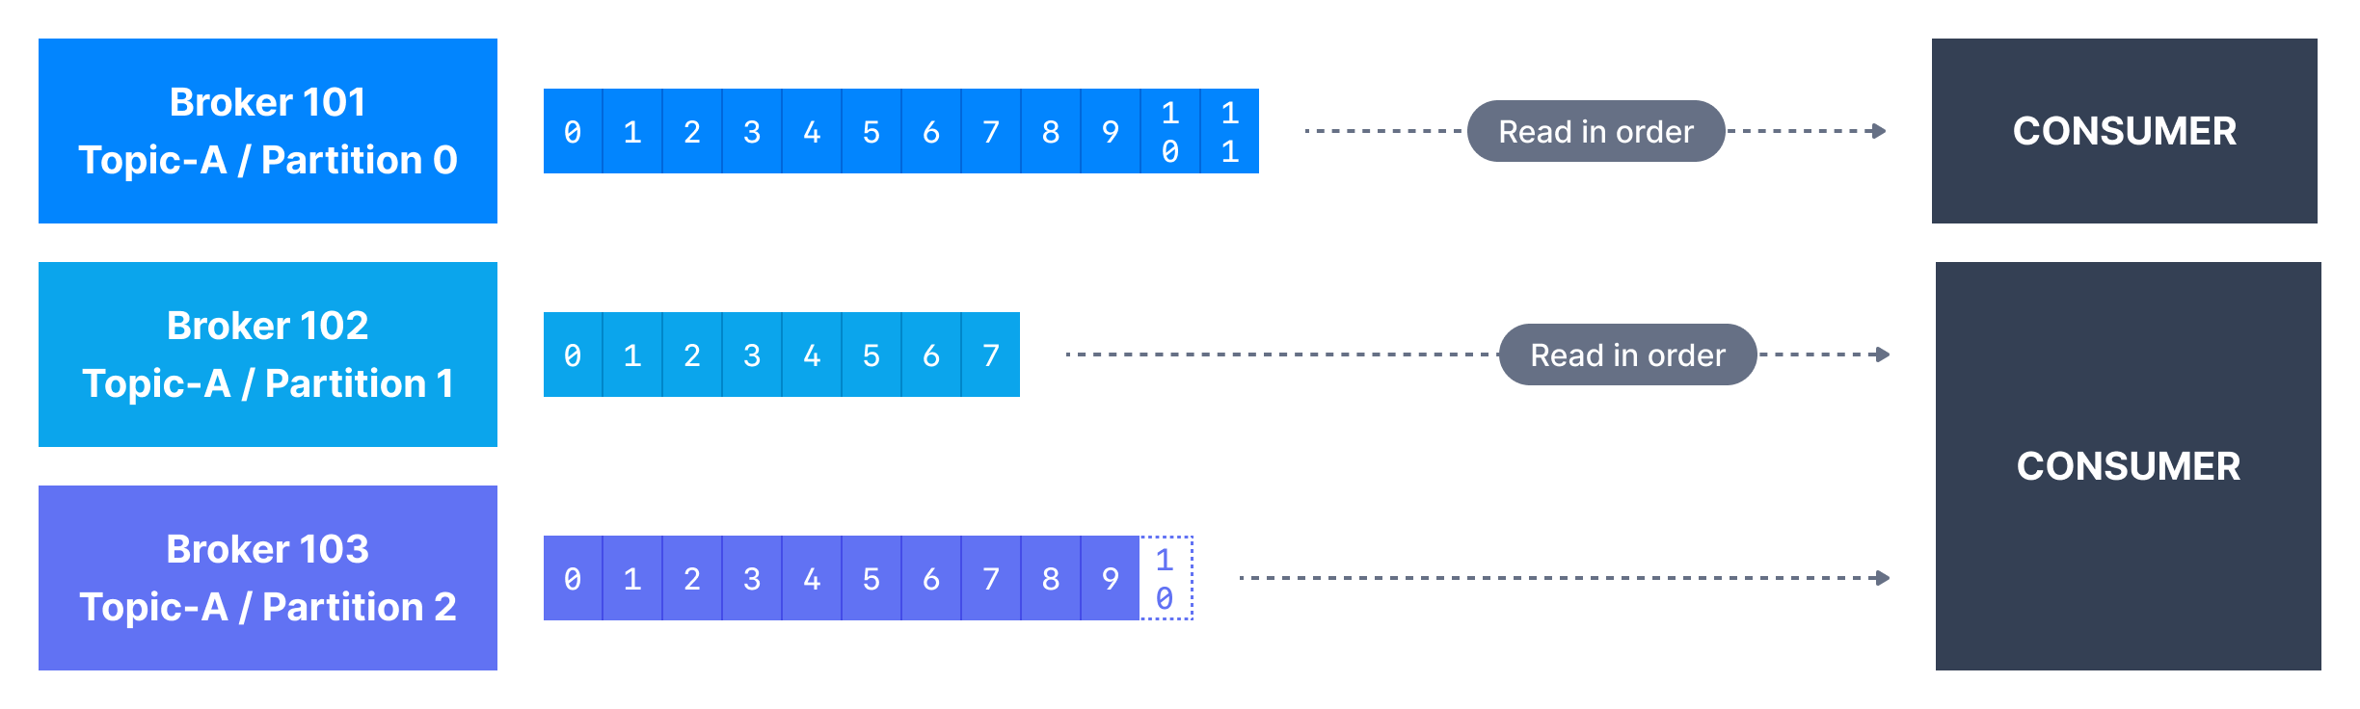
Kafka Consumers
Consumers can read from one or more partitions at a time, and data is read in order within each partition.
A consumer always reads data from a lower offset to a higher offset and cannot read data backwards.
If the consumer consumes data from more than one partition, the message order is not guaranteed across multiple partitions because they are consumed simultaneously, but the message read order is still guaranteed within each individual partition.

Slide 23
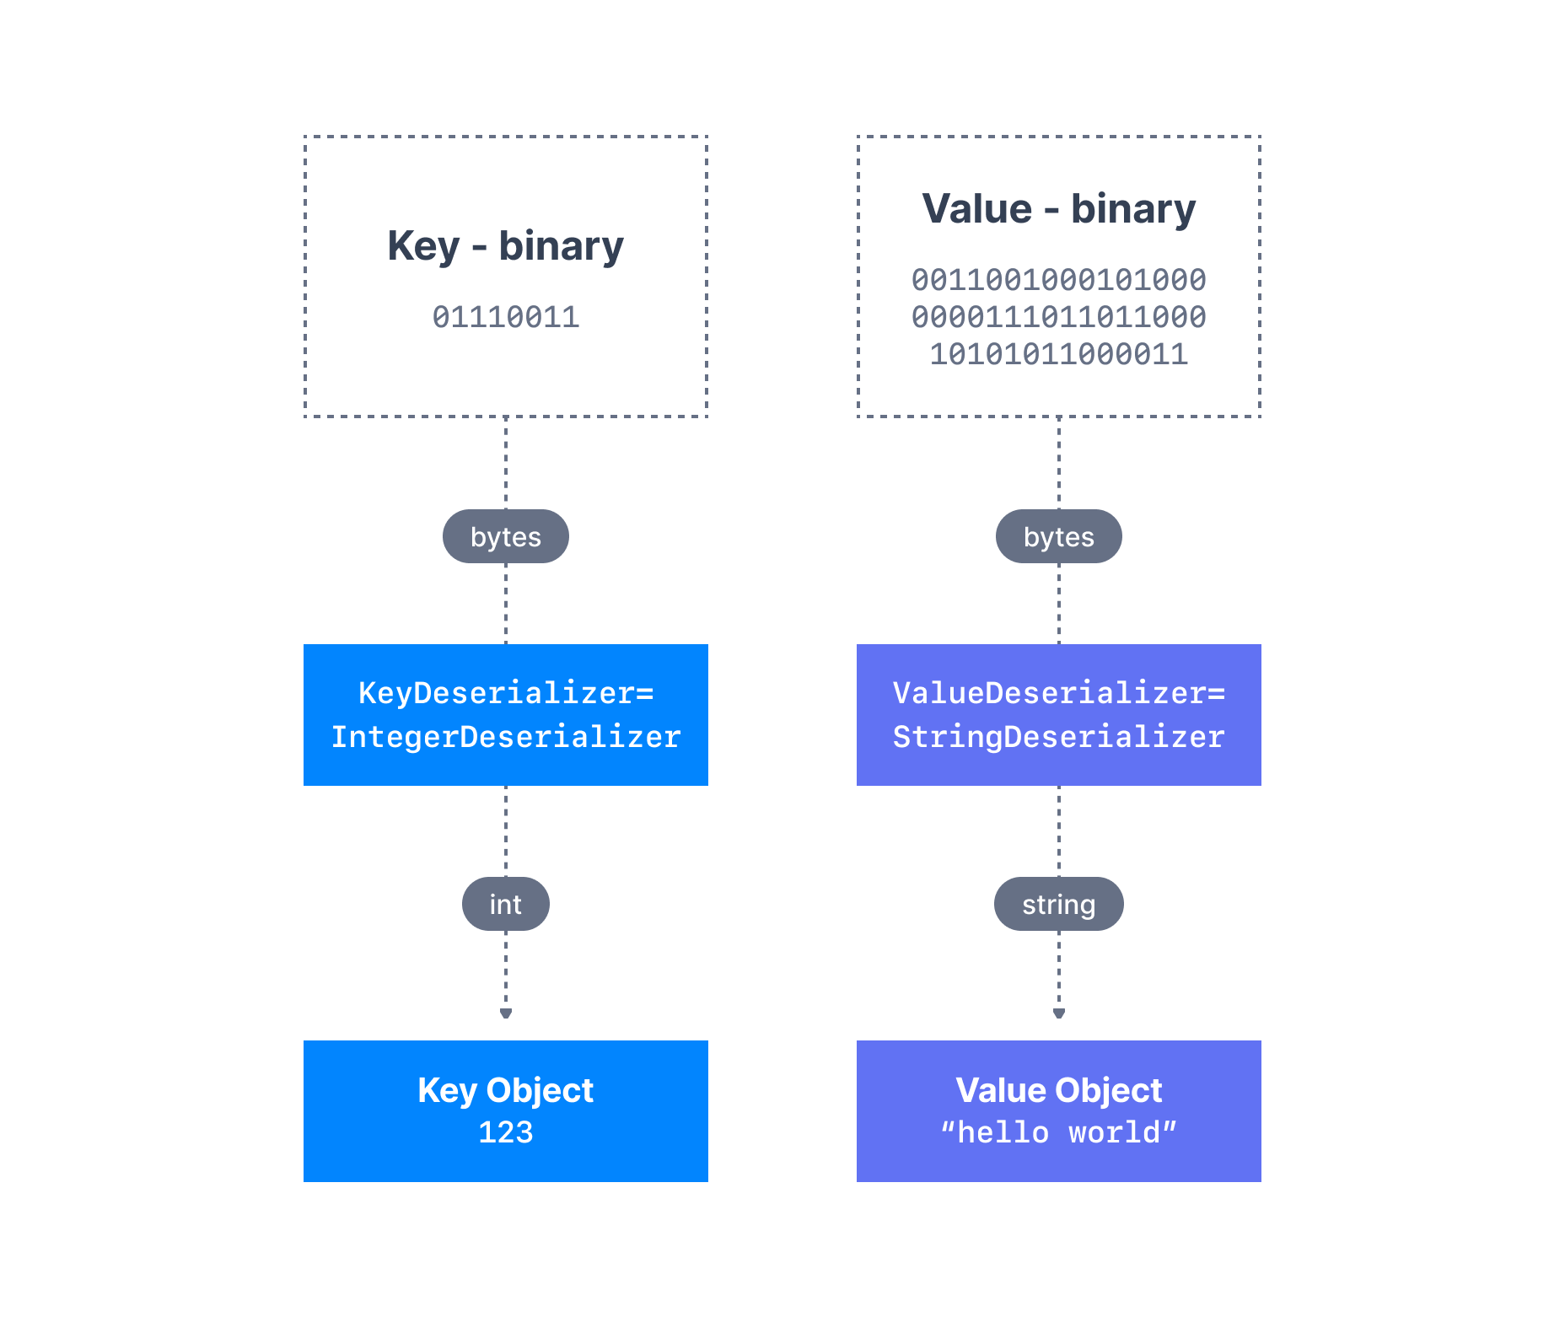
Kafka Message Deserializers
The data sent by the Kafka producers is serialized.
This means that the data received by the Kafka consumers must be correctly deserialized.
Data being consumed must be deserialized in the same format it was serialized in.

Slide 24
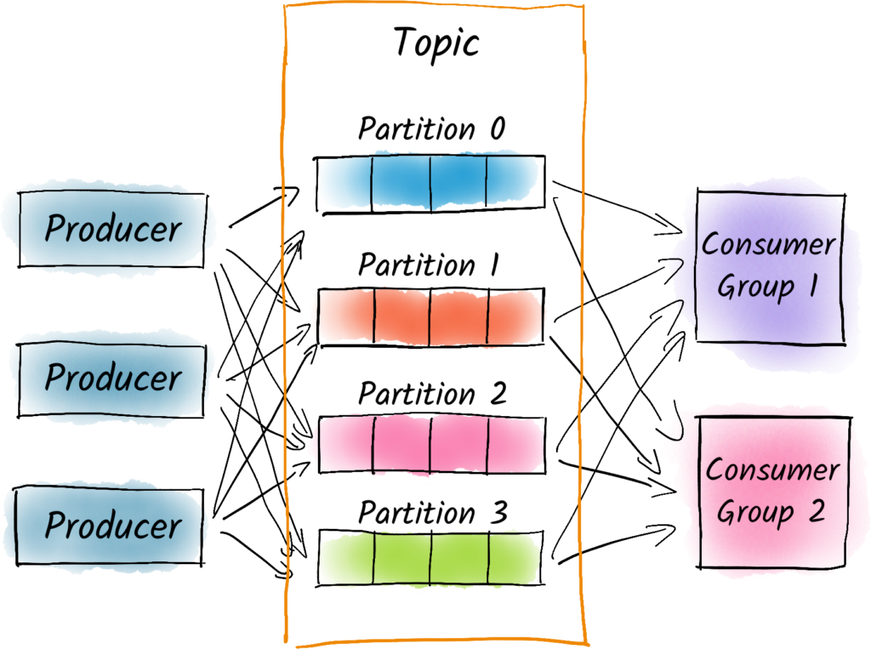
Kafka Consumer Groups
A topic usually consists of many partitions. These partitions are a unit of parallelism for Kafka consumers.
The benefit of leveraging a Kafka consumer group is that the consumers within the group will coordinate to split the work of reading from different partitions.
Kafka Consumers automatically use a GroupCoordinator and a ConsumerCoordinator to assign consumers to a partition and ensure the load balancing is achieved across all consumers in the same group.
Notes:
It is important to note that each topic partition is only assigned to one consumer within a consumer group, but a consumer from a consumer group can be assigned multiple partitions.

Slide 25
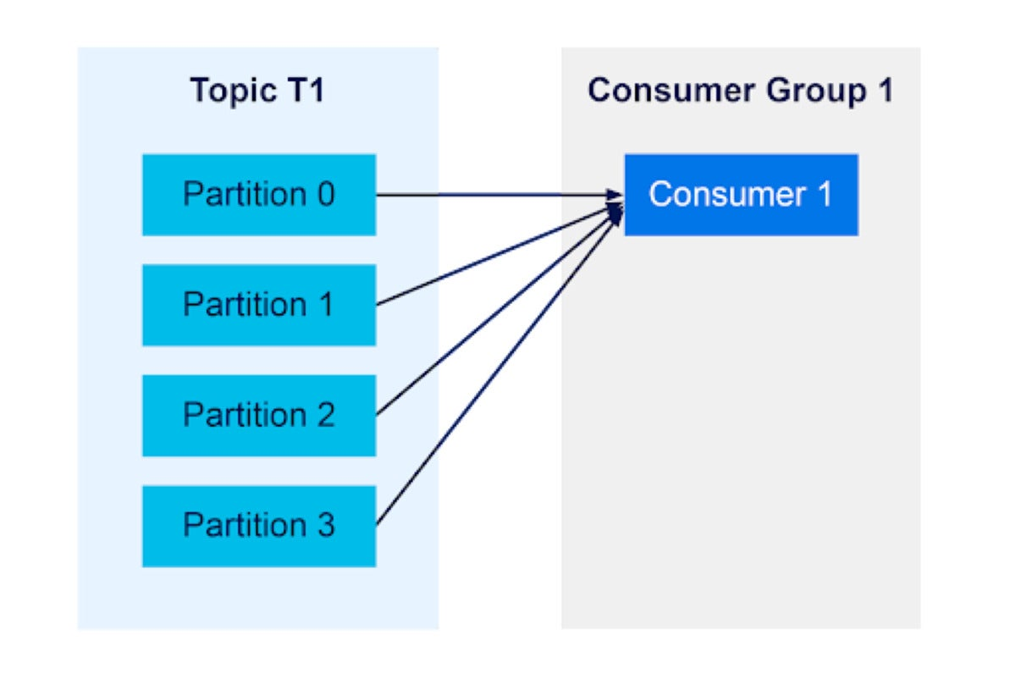
Kafka Consumer Groups
Notes:
A consumer group with a single consumer will receive messages from all of a topics’ partitions.

Slide 26
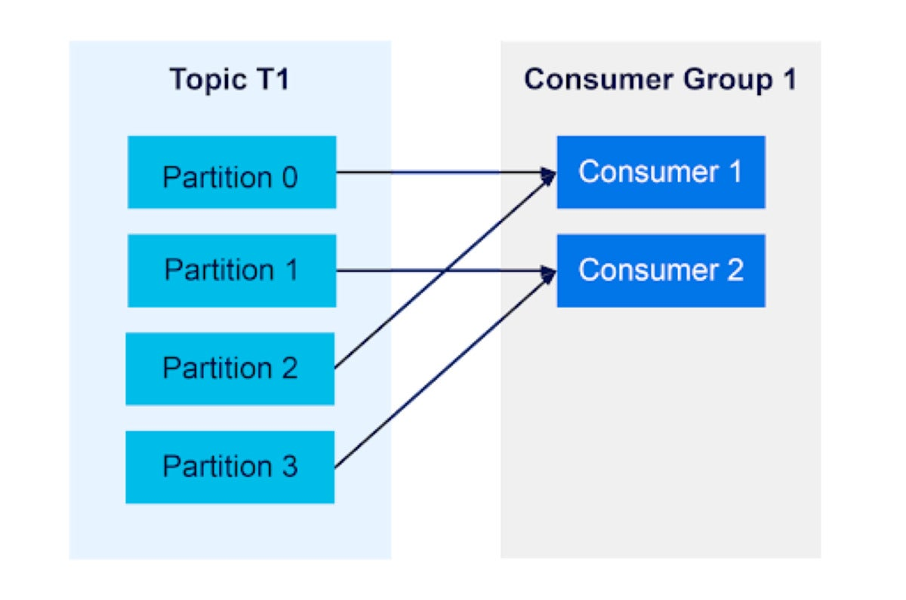
Kafka Consumer Groups
Notes:
A consumer group with two consumers will each receive messages from half of the topic partitions.

Slide 27
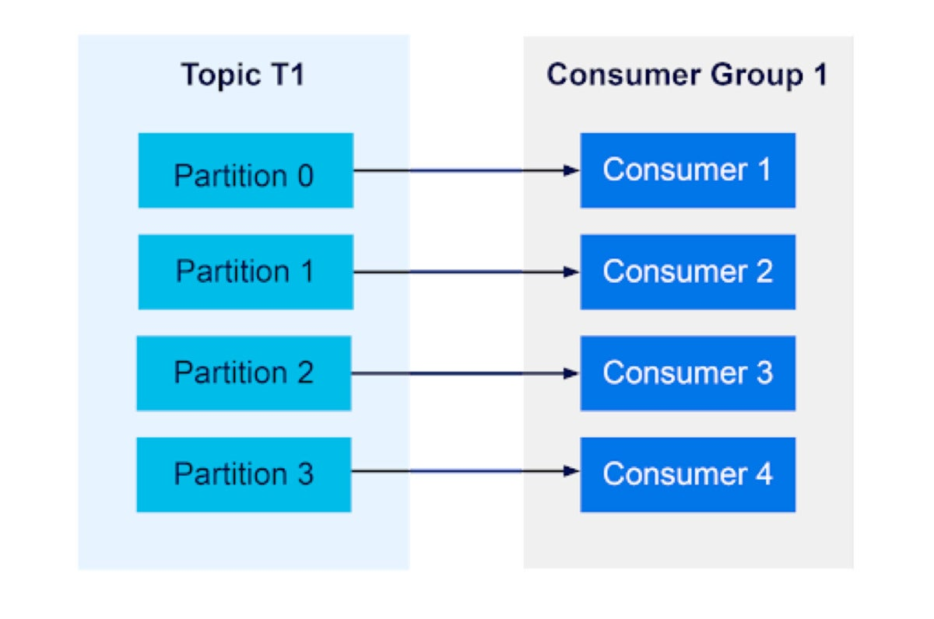
Kafka Consumer Groups
Notes:
Consumer groups will balance their consumers across partitions, up until the ratio is 1:1.

Slide 28
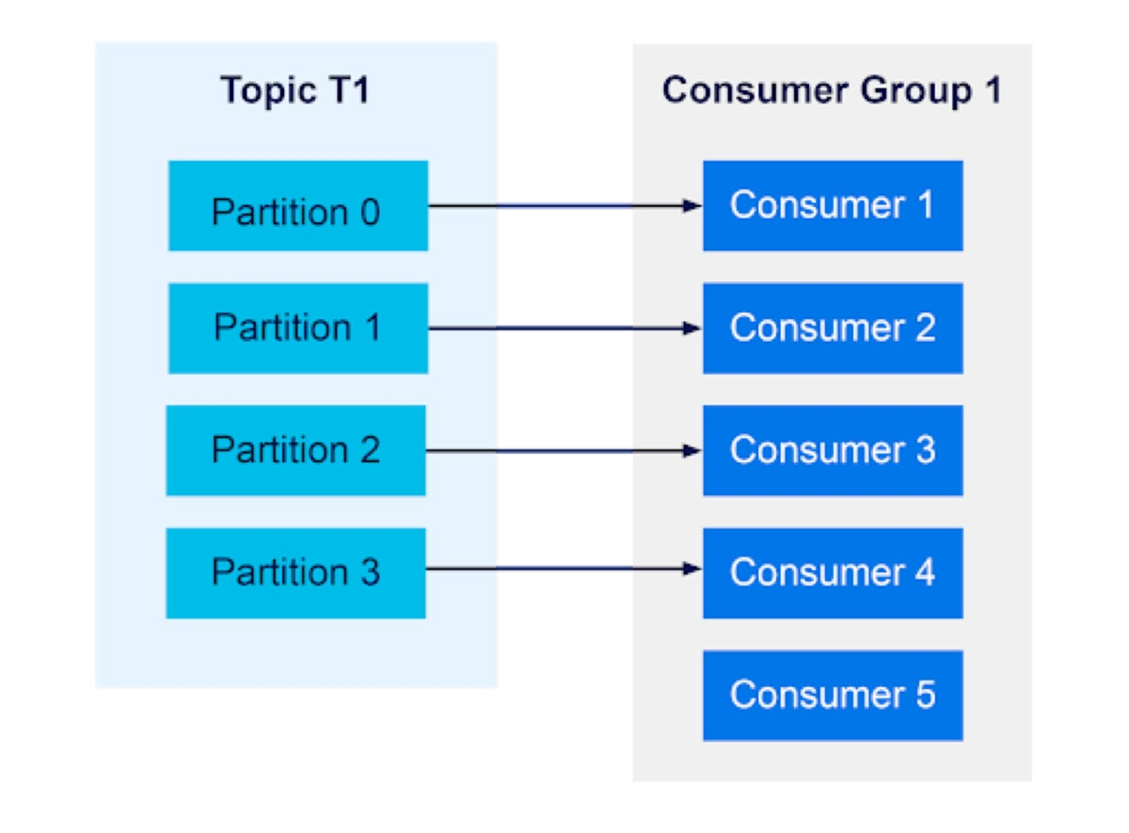
Kafka Consumer Groups
Notes:
However, if there are more consumers than partitions, any extra consumers will not receive messages.

Slide 29
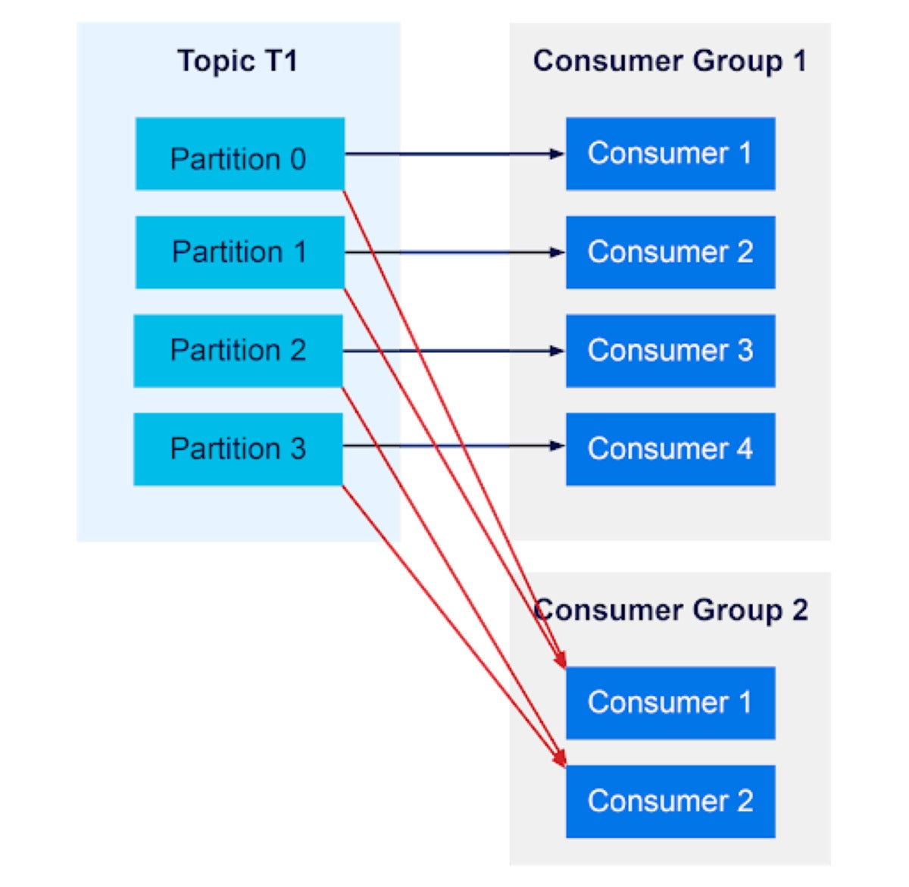
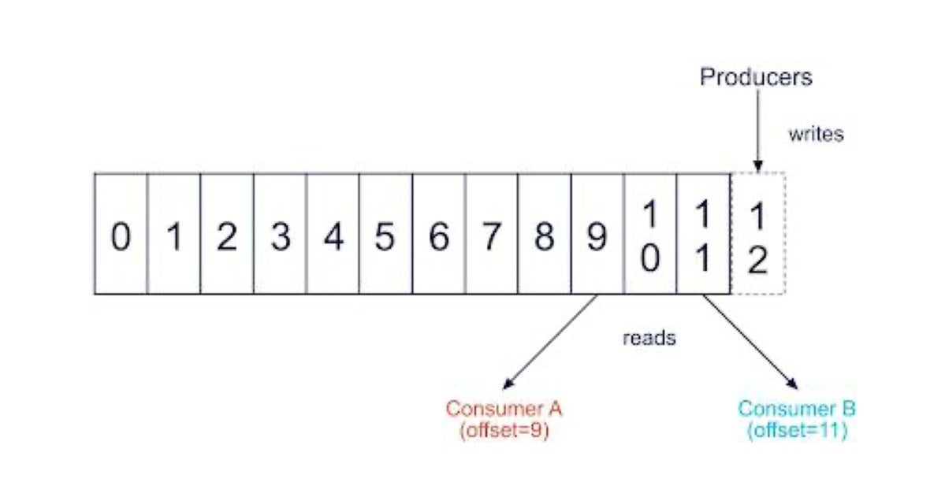
Kafka Consumer Groups
A Kafka consumer keeps track of an offset: the position in the queue of each message it has read.
There is an offset for every partition, in every topic, and for each consumer.

Slide 30
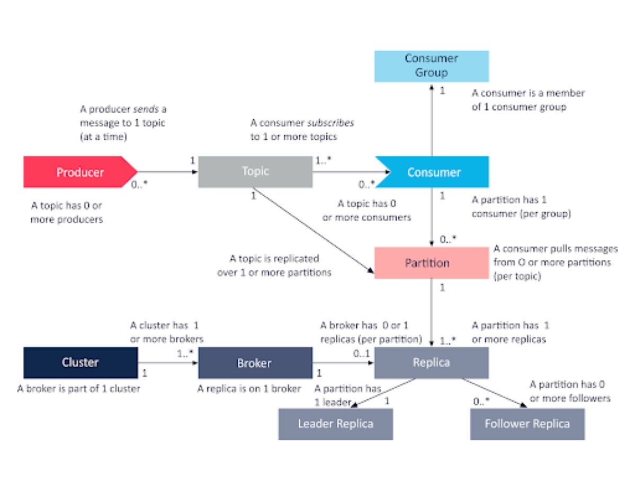

Slide 31
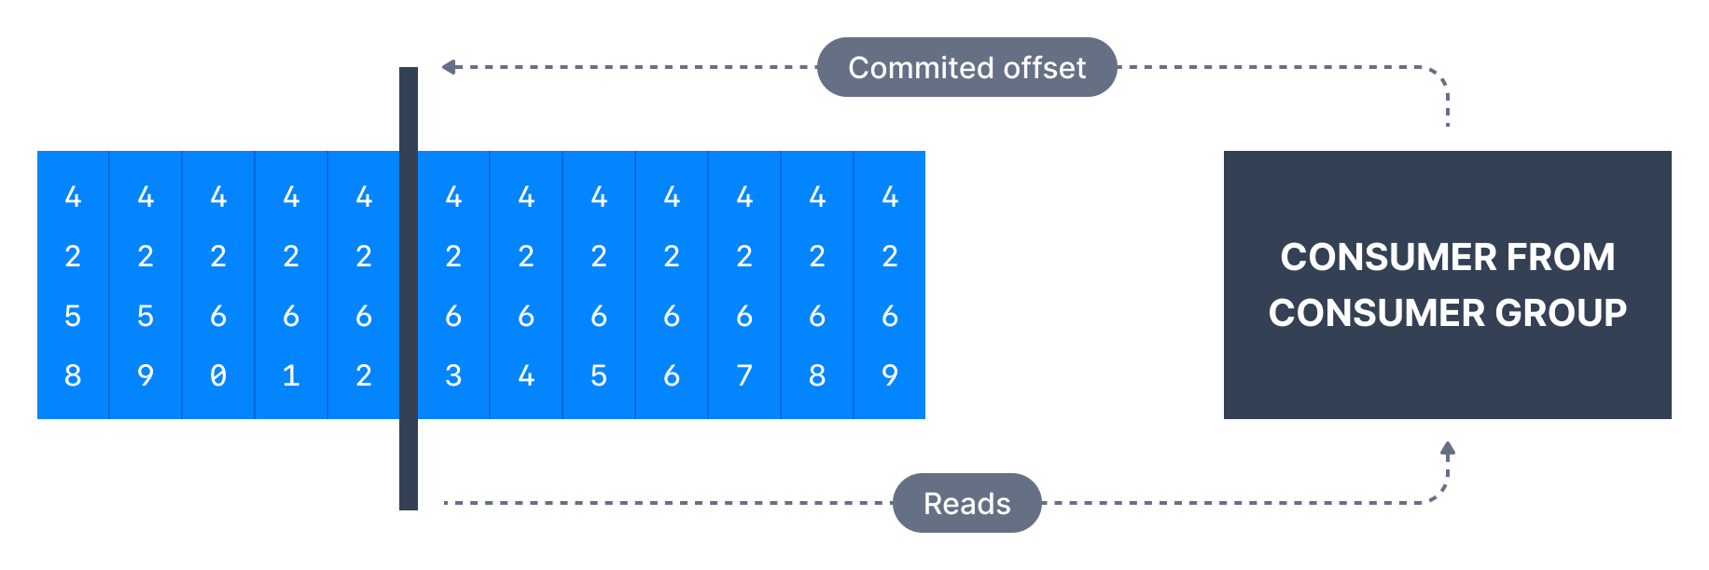
Kafka Consumer Offsets
Kafka brokers use an internal topic named __consumer_offsets that keeps track of what messages a given consumer group last successfully processed.
Each message in a Kafka topic has a partition ID and an offset ID attached to it.
Therefore, in order to "checkpoint" how far a consumer has been reading into a topic partition, the consumer will regularly commit the latest processed message.

Slide 32
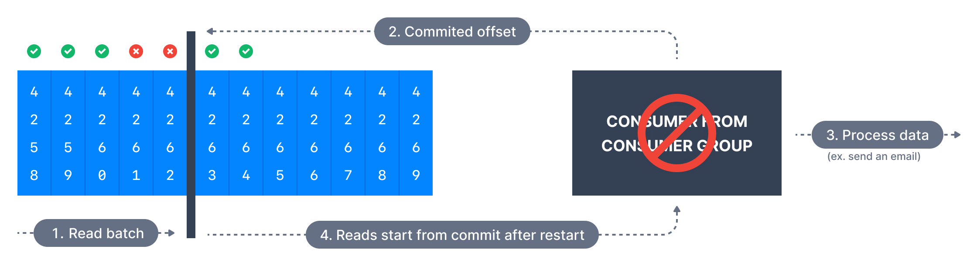
Delivery semantics for consumers
At most once
In this case, a consumer reads a set of messages, saves its position in the log, and then processes the messages.
If the consumer process crashes after saving its position, but before saving the output of its message processing, the consumer that takes over processing would start at the saved position and the messages prior to that position would not be processed.
This is at-most-once semantics for the consumer, because in a failure, messages may not be processed.

Slide 33
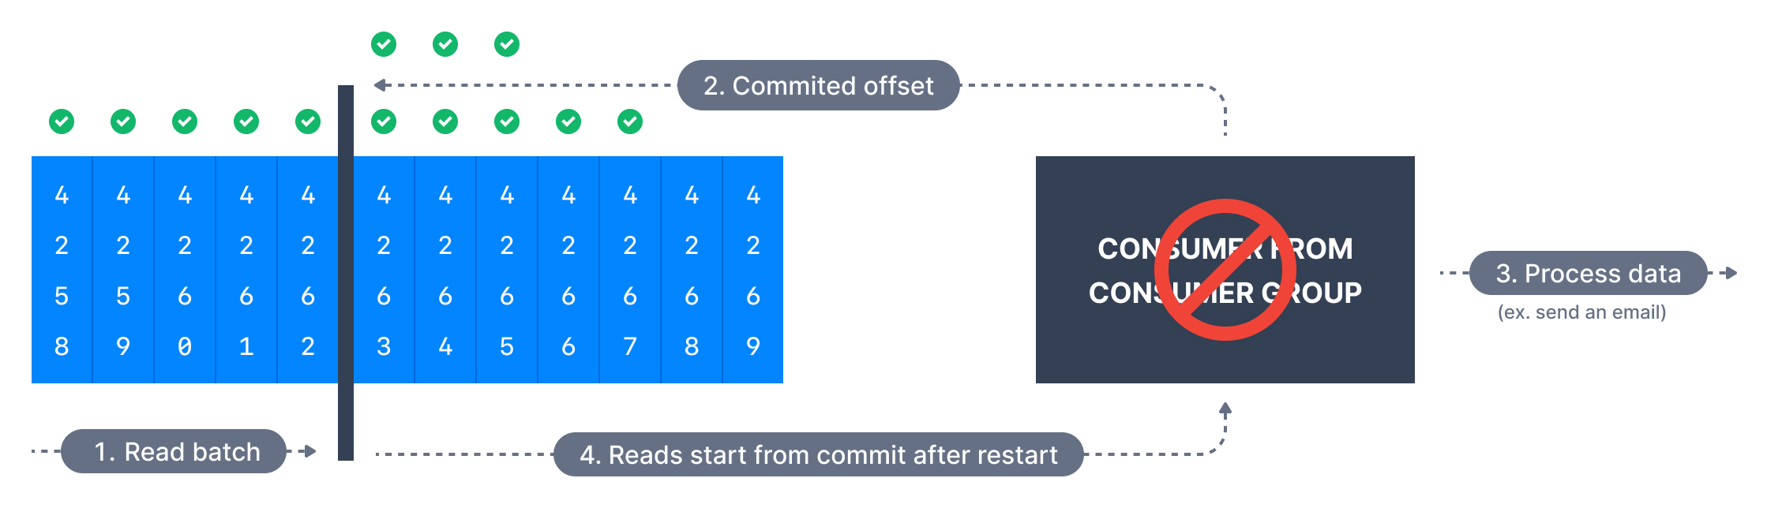
Delivery semantics for consumers
At least once (usually preferred)
This means a consumer reads a set of messages, processes the messages, and then saves its position.
In this case, if the consumer process crashes after processing messages, but before saving its position, the new process that takes over may process some messages a second time.
In this case, you can assign messages a primary key, so that updates are idempotent, meaning that if the message is received twice, it just overwrites the existing record with the same message data.

Slide 34
Delivery semantics for consumers
Exactly once
This can only be achieved for Kafka topic to Kafka topic workflows using the transactions API. The Kafka Streams API simplifies the usage of that API and enables exactly once using the setting processing.guarantee=exactly.once.
The consumer’s position is stored as a message in a topic, so offset data in written to Kafka in the same transaction as when processed data is written to the output topics.
If the transaction is aborted, the consumer’s position reverts to its old value and you can specify whether output topics are visible to other consumers using the isolation_level property.
For the default isolation level, read_uncommitted, all messages, even ones in aborted transactions, are visible to consumers. In read_committed, the consumer only reads messages from committed transactions.
Notes:
When writing to an external system, it can be challenging to coordinate the data the consumer is receiving and the consumer’s position in the data. Typically, this might be done with a two-phase commit, storing the consumer position, and then storing the consumed data. In contrast, Kafka stores the position in the same place it stores the consumed data. For example, a Connect connector populates data in Hadoop Distributed File System (HDFS) along with the offsets of the data it reads so that it is guaranteed that both data and offsets are updated, or neither is.

Slide 35
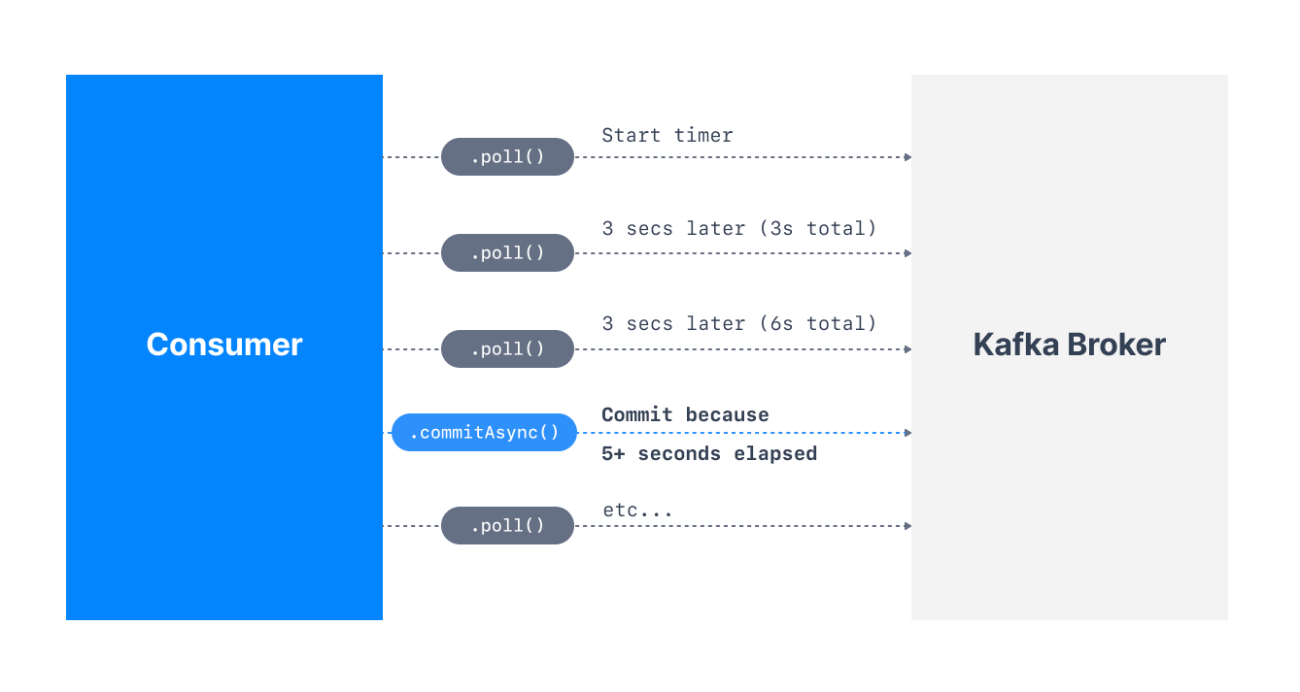
Automatic Offset Committing Strategy
Using the Kafka Consumer Java API, offsets are committed regularly and automatically in order to enable at at-least once reading scenario.
By default, the property enable.auto.commit=true and therefore offsets are committed automatically with a frequency controlled by the config auto.commit.interval.ms .

Slide 36

Consumer Auto Offsets Reset Behavior
A consumer is expected to read from a log continuously.
Kafka consumers have a configuration for how to behave when they don’t have a previously committed offset. (retention of 7 days)
Consumers have a choice to either start reading from the beginning of the partition or from the end of the partition. This is controlled by the consumer configuration - auto.offset.reset [latest(default), earliest, none].
Notes:
Kafka consumers have a configuration for how to behave when they don’t have a previously committed offset. This can happen if the consumer application has a bug and it is down. For example, if Kafka has a retention of 7 days, and your consumer is down for more than 7 days, the offsets are "invalid" as they will be deleted.

Slide 37
Retention Period
The default retention period for message offsets in Kafka (version >= 2.0) is one week (7 days). It is a broker level setting. It is the offset retention period for the __consumer_offsets topic (in minutes).
This setting is particularly helpful to increase in case you expect your consumers to be down for more than 1 week (and therefore lose their committed offsets), or if your topics are low-throughput topics and the consumer has not processed data for more than 1 week.

Slide 38
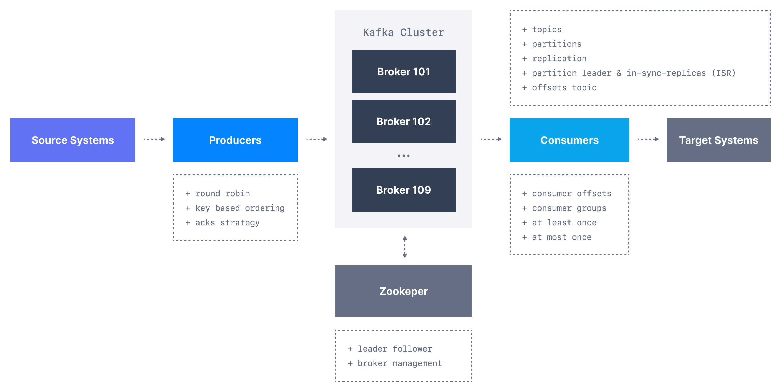
Apache KafkaWorkflows

Slide 39
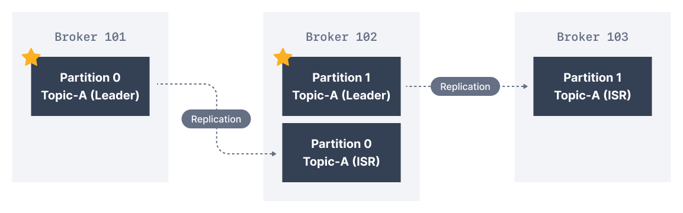
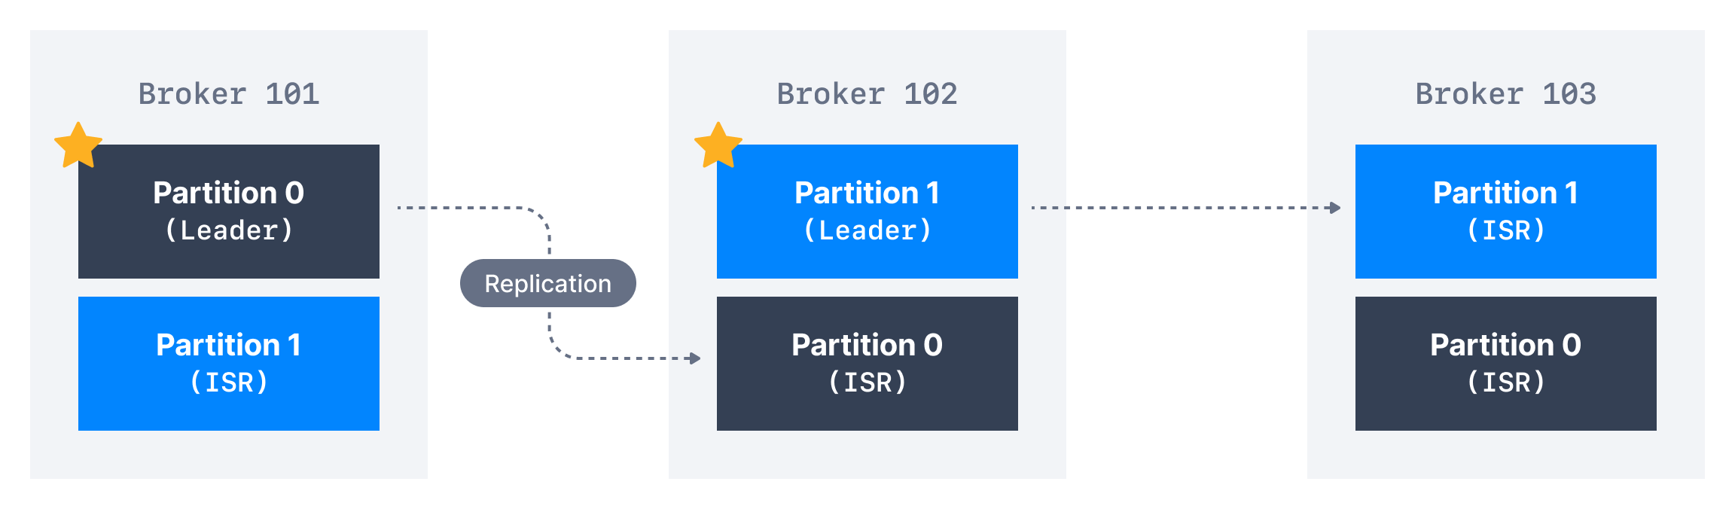
In-Sync Replicas (ISR)
An ISR is a replica that is up to date with the leader broker for a partition.
Any replica that is not up to date with the leader is out of sync.

Slide 40
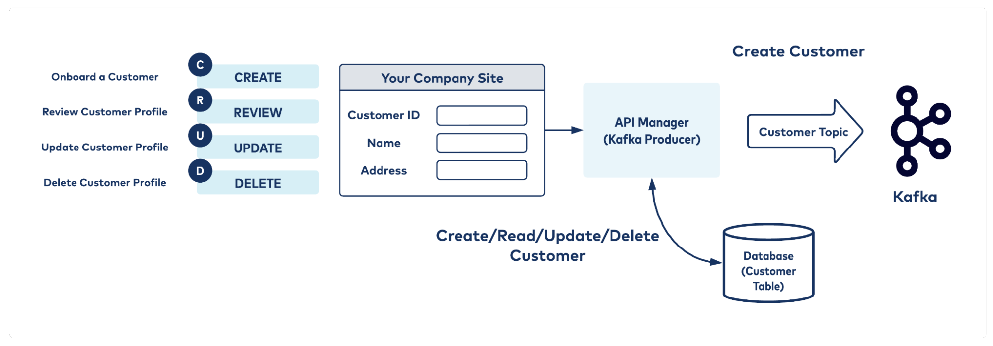
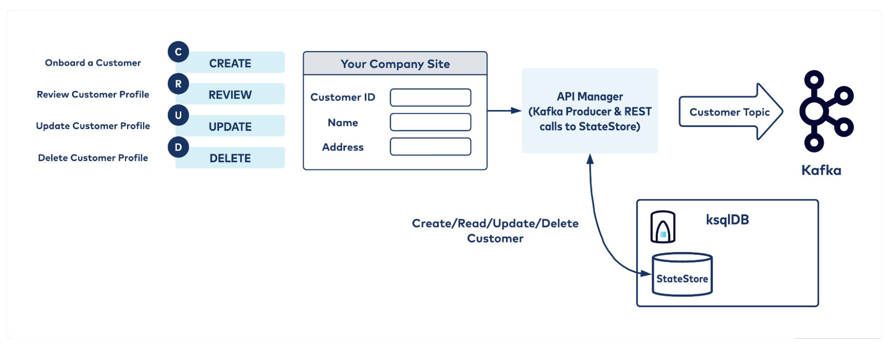
Kafka as a Database
Kafka has properties similar to a database as well as log compaction, state store, and materialized views.
Log compaction ensures that Kafka always retains the last known value for each record key.
Notes:
Apache Kafka has another interesting feature not found in RabbitMQ - log compaction.

Slide 41
Using State Store
Produce data to Kafka (in AVRO/JSON/Protobuf format)
Ensure produced data uses a valid message key
Use ksqlDB to create a materialized view on that topic
Use ksqlDB REST API to make calls to the state store
Cons:
State store by default runs on a single node (can be configured to have standby nodes) and hence the storage is not highly available.
In the event that the hosting node/storage is lost, the state store has to be rebuilt from the changelog topic (alternatively, you can keep a cold state store ready as standby)
Cannot execute complex queries

Slide 42
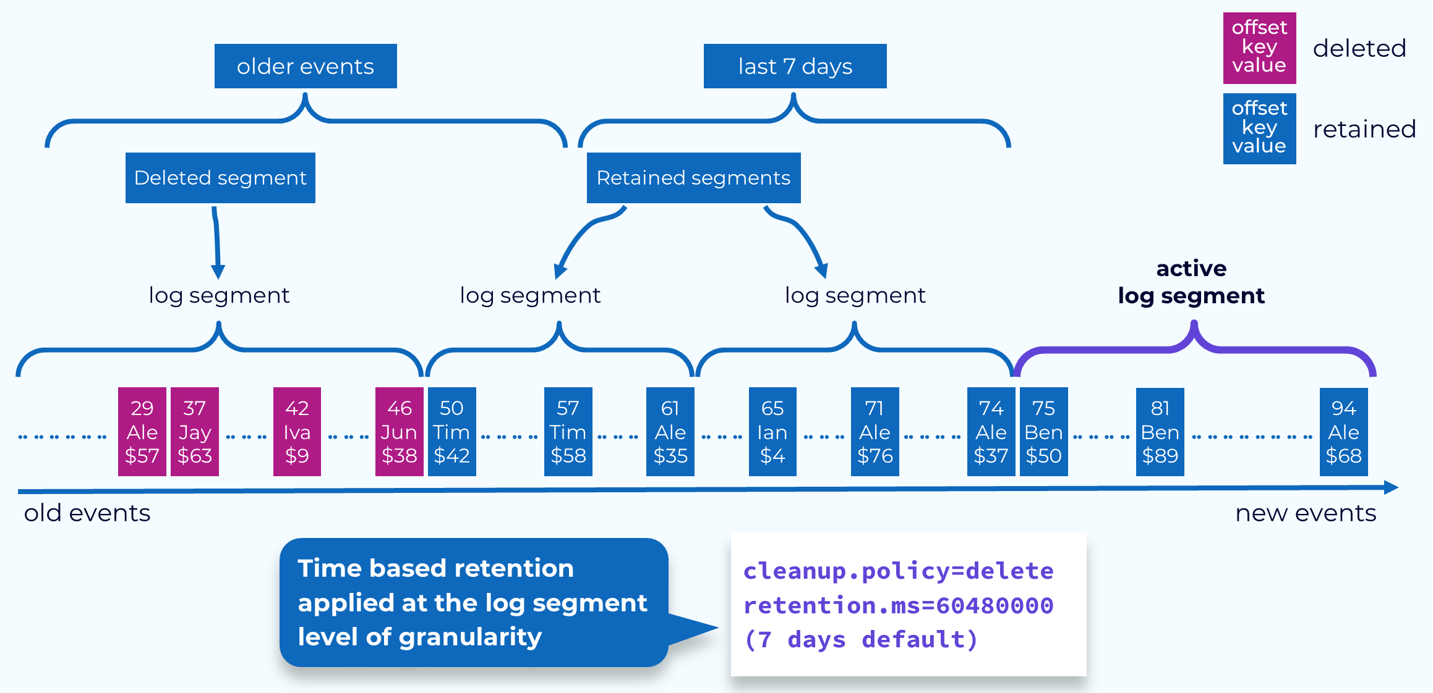
Topic Compaction
Time-Based Retention
It’s specified by setting the cleanup.policy to delete and setting the retention.ms to some number of milliseconds.
Once they have hit that limit, they may not be deleted right away.
Source: https://developer.confluent.io/courses/architecture/compaction/

Slide 43
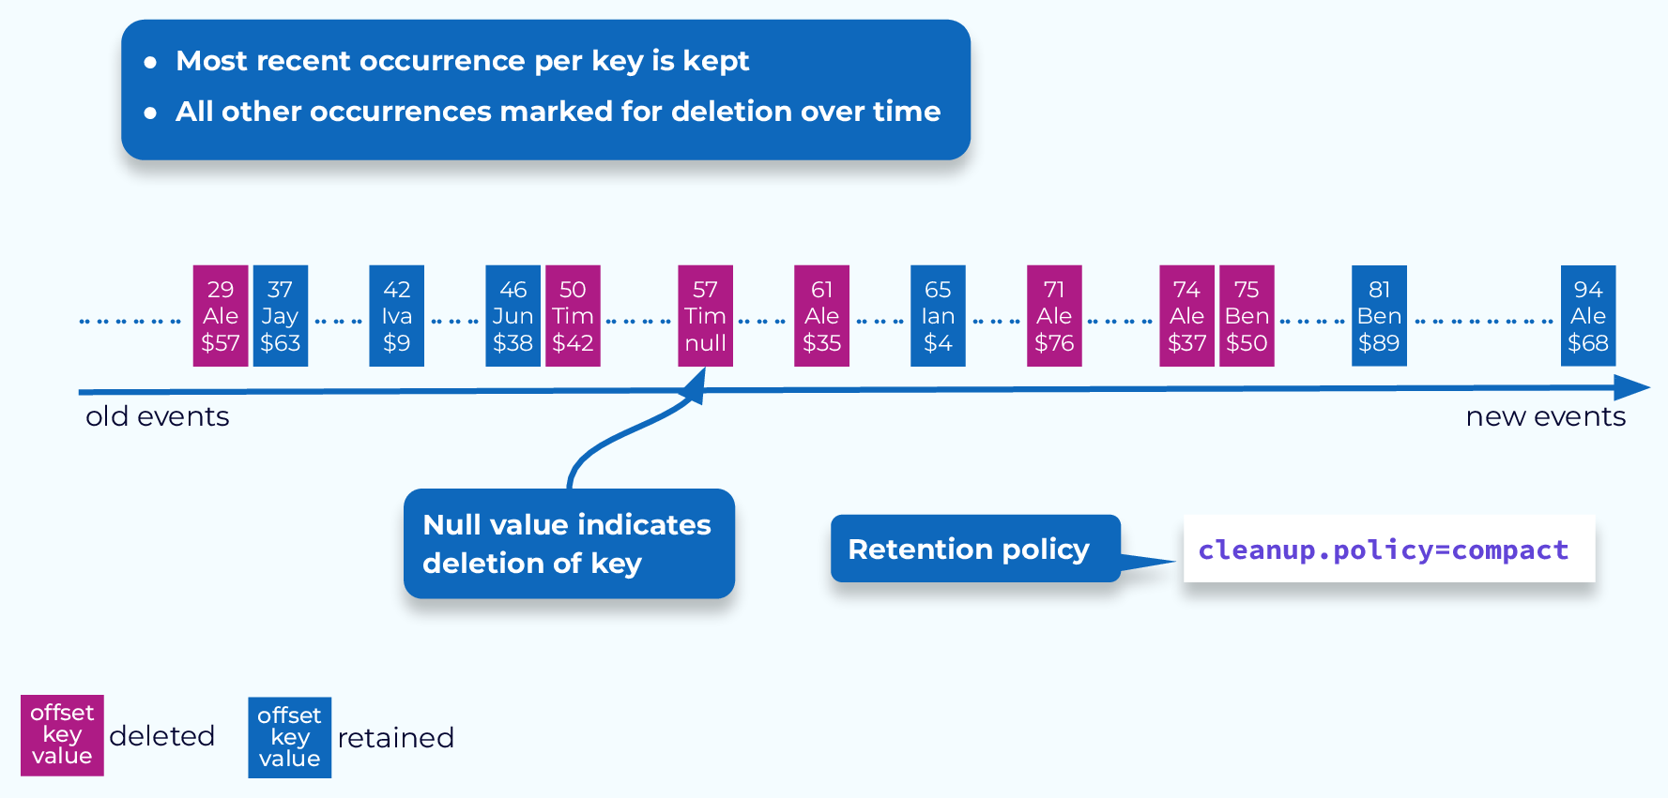
Topic Compaction
Key-Based Retention
Compaction is a key-based retention mechanism.
To set a topic to use compaction, set its cleanup.policy to compact.
The goal of compaction is to keep the most recent value for a given key.
Source: https://developer.confluent.io/courses/architecture/compaction/

Slide 44
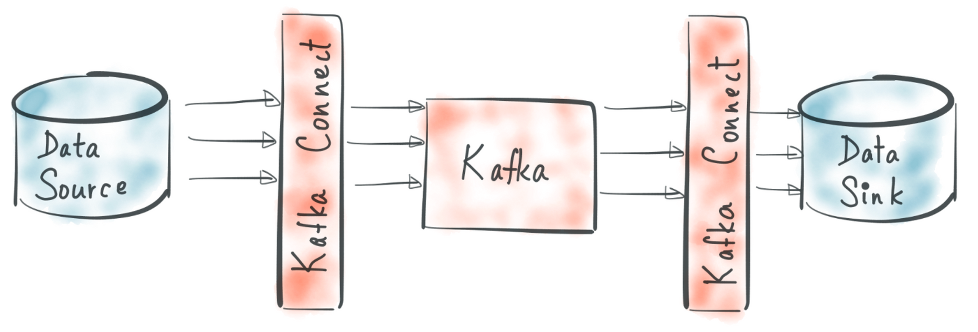
Kafka Connect
Kafka Connect is a framework for connecting Kafka to other systems such as databases, key-value stores, search indexes, and file systems through the use of Connectors.
Because Kafka Connect is only used to replicate streaming data, its reach is limited. It functions as an independent testing procedure as well as a distributed, scalable service support for an organization.

Slide 45
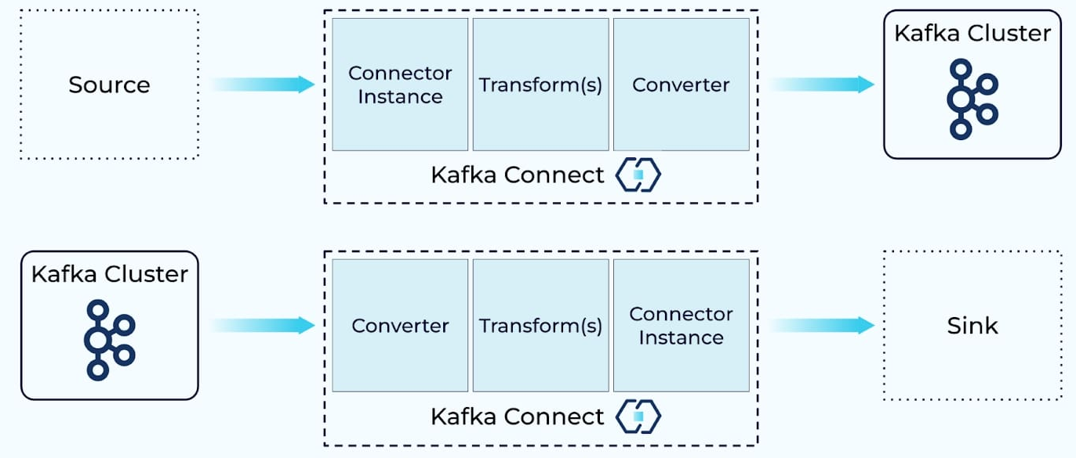
Kafka Connect
Connectors are used to indicate the transformations to be made to the data as it passes between the source and sink systems and to define the source and sink systems.

Slide 46
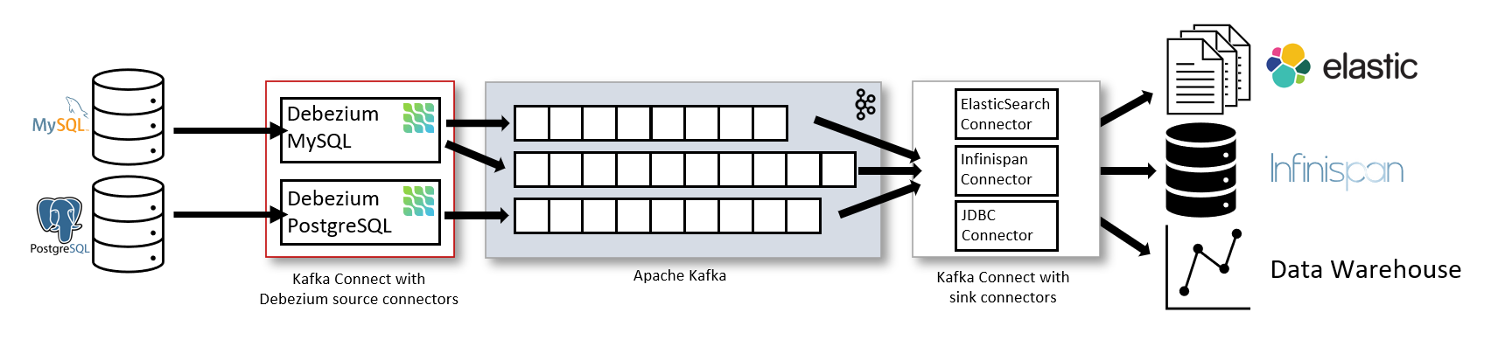
Change Data Capture with Debezium

Slide 47
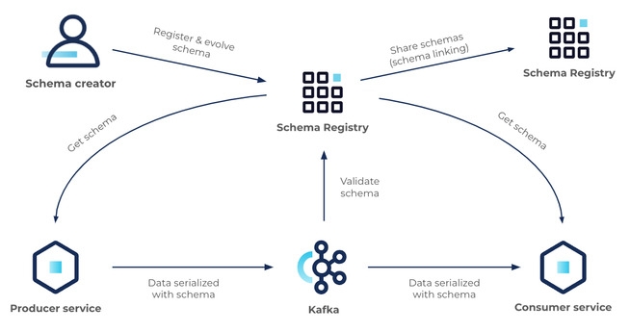
Schema Registry
Schema Registry is a key component of Stream Governance.
Allows producers and consumers to communicate over a well-defined data contract in the form of a schema
Controls schema evolution with clear and explicit compatibility rules
Optimizes the payload over the wire by passing a schema ID instead of an entire schema definition
At its core, Schema Registry has two main parts:
A REST service for validating, storing, and retrieving Avro, JSON Schema, and Protobuf schemas
Serializers and deserializers that plug into Apache Kafka® clients to handle schema storage and retrieval for Kafka messages across the three formats

Slide 48
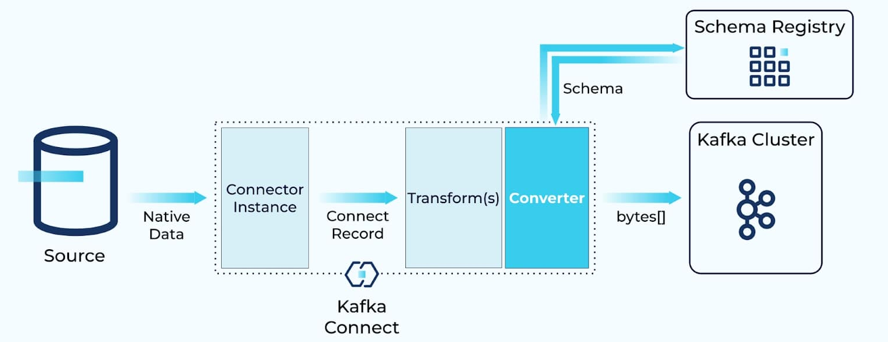
Kafka Connect & Serialization - Schemas

Slide 49
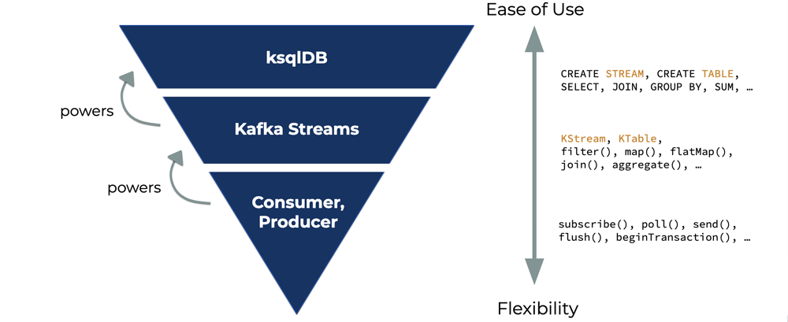
ksqlDB
ksqlDB is an event streaming database built on top of Kafka Streams that provides a high-level SQL syntax, which can build streams and tables, create and serve materialized views, and manage Kafka connectors.
Stream processing: rekeying a stream of records from an existing record value and publishing to a new stream.

Slide 50
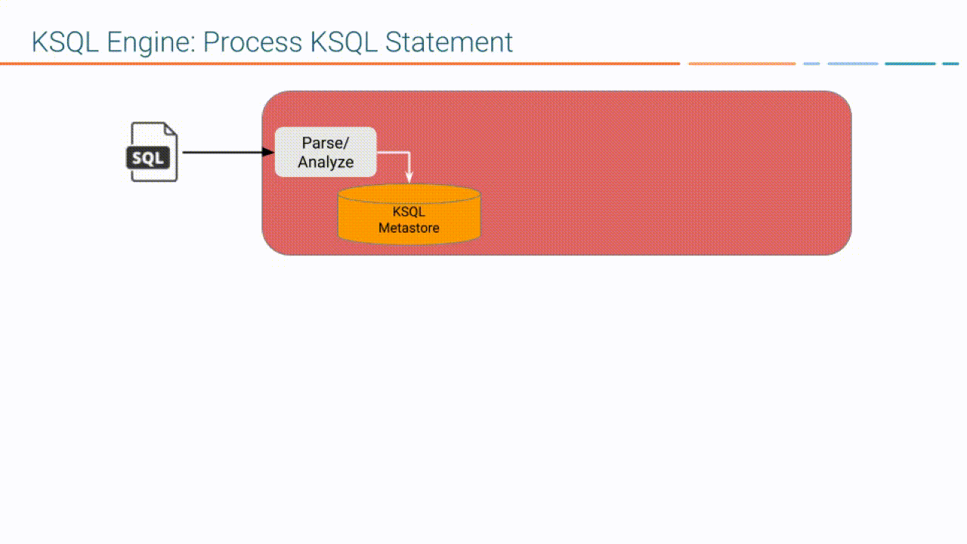
Notes:
Source: https://docs.ksqldb.io/en/latest/operate-and-deploy/how-it-works/

Slide 51
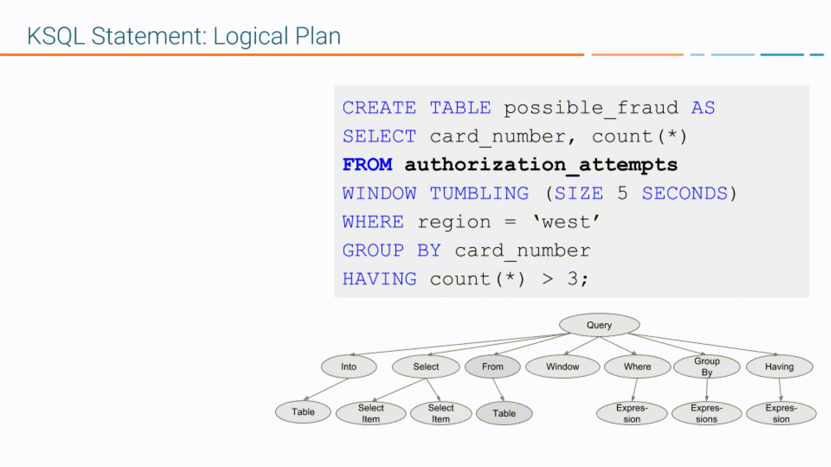
Notes:
Source: https://docs.ksqldb.io/en/latest/operate-and-deploy/how-it-works/

Slide 52
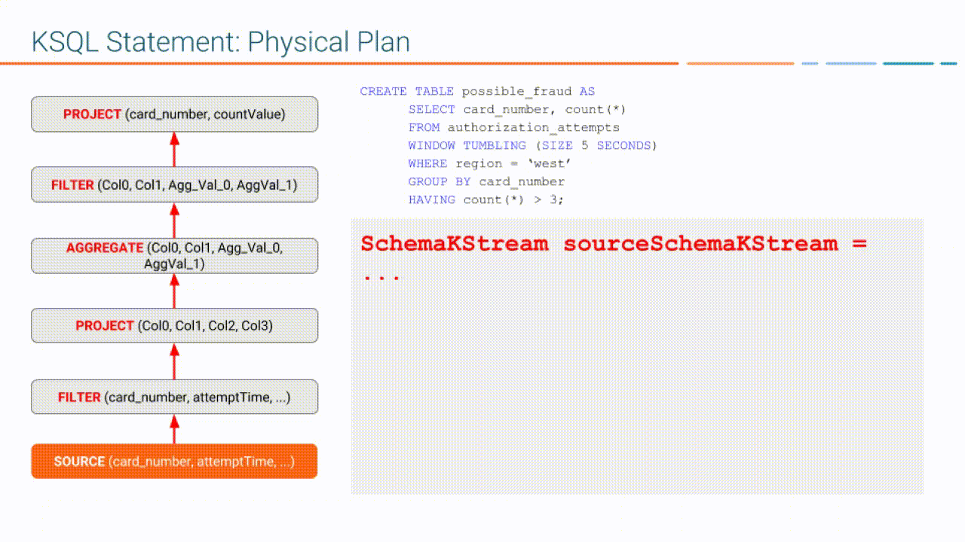
Notes:
Source: https://docs.ksqldb.io/en/latest/operate-and-deploy/how-it-works/

Slide 53
kafka-topics.sh
Use to create, delete, or change a topic.
You can also use the tool to retrieve a list of topics associated with a Kafka cluster. More Detail: Topic Operations
./bin/kafka-topics.sh --bootstrap-server host1:9092 --topic test-topic --partitions 3
./bin/kafka-topics.sh --bootstrap-server broker_host:port --create --topic my_topic_name \
--partitions 20 --replication-factor 3 --config x=y
./bin/kafka-topics.sh --bootstrap-server broker_host:port --delete --topic my_topic_name

Slide 54
kafka-configs.sh
Use this tool to change and describe topic, client, user, broker, ip, or cluster link configuration settings.
To change a property, specify the entity-type to the desired entity (topic, broker, user, etc), and use the alter option.
/bin/kafka-configs.sh --bootstrap-server host1:9092 --entity-type topics --entity-default --alter --add-config delete.retention.ms=172800000

